Slide 1
Elasto-plastic assessment of Nb tuner interface (DQW)
Carlo Zanoni 11/04/2016

Slide 2
Plastic Strain

Slide 3
Assessment
$ε_{Plastic strain}+ε_{fabr strain}≤ε_{LU}exp\left(−\left(\frac{α_{sl}}{1+m_{2}}\right)\left(\frac{σ_{1}+σ_{2}+σ_{3}}{3 σ_{eq}}−\frac{1}{3}\right)\right)⁡$
where the parameters are described in the ASME standard (BPVC VIII – 2)
A load with a 1.7x margin must be applied

Slide 4
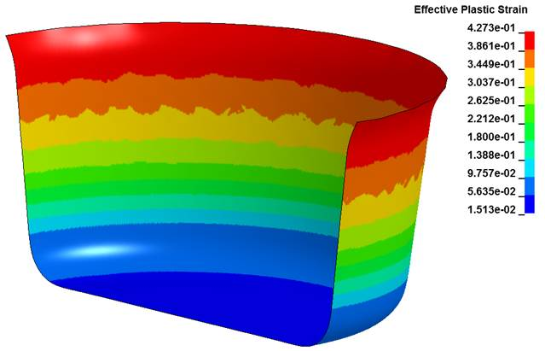
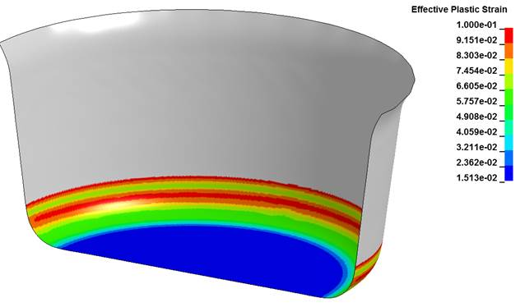
Fabrication Plastic Strain
A value of 5 % has been assumed for the location of interest
Courtesy of Alexandre

Slide 5
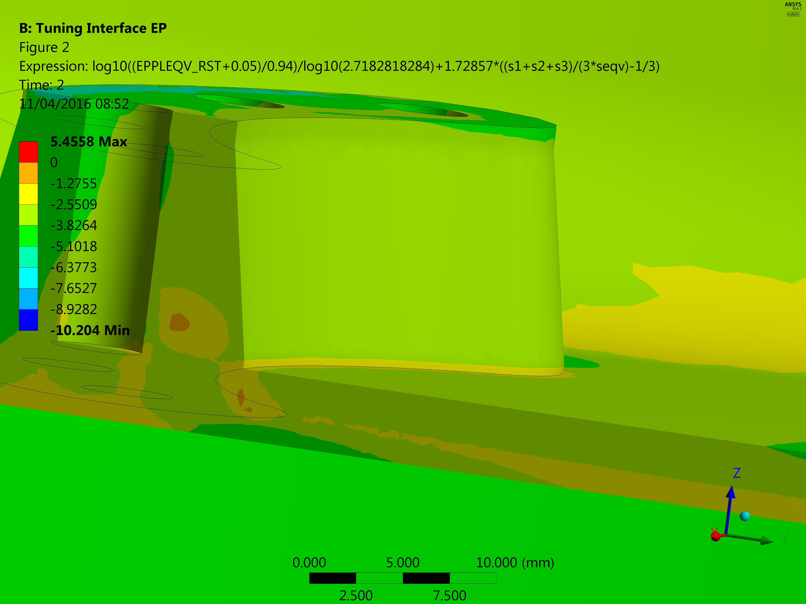
Assessment (failed when > 0)

Slide 6
Conclusions
Local assessment is successful (in fact, plastic strain is extremely limited)
Unexpected numerical errors are also present in such an approach, but we may have found the reason

