Slide 1
Economic effects of democracy
Political Economy of the Global South
Prof. Tyson Roberts

Slide 2
How does democracy in the Global South affect economic growth and other economic outcomes?

Slide 3
Argument that democracy is bad for growth
In poor countries, democracy unleashes pressures for immediate consumption => less investment => less growth
Galenson & de Schweinitz (1959)
Dictatorship => less consumption/more investment => more growth
Rao (1984)

Slide 4
More details on “democracy bad for growth” argument
Poor people want to consume immediately
When workers can organize, wages ⬆ => profits ⬇ => investment ⬇
When people can vote, government distribute more and invest less
Investment ⬆ => growth⬇

Slide 5
Some blame India’s democracy for economic problems (Economist (2012): The democracy bottleneck)
Indian coalition government unable to push through reforms
Government spending on subsidies for fuel & electricity (and debt) instead of investment and social programs (education, etc.)
Government spending also on unprofitable SOEs to protect public sector jobs

Slide 6
Arguments that democracy is good for growth
Democracies are more accountable to voters => protect property rights => investment ⬆ => growth ⬆
Democracy are more accountable to voters => optimal investment in public services => growth ⬆
Dictators fear empowered voters => undersupply public services => growth ⬇
Democracies allow free flow of information => resource allocation efficiency ⬆ => growth ⬆

Slide 7
These arguments are not mutually exclusive; if true, may cancel each other out

Slide 8
Ingredients of Growth
Solow Model (based on Cobb-Douglas)
y = Ak^{α}l^{β} ; α + β = 1
K = capital (investment in machines, etc.)
L = labor (workers)
α + β = 1 => Diminishing returns to capital & labor
A = Total factor productivity (technology, etc.)
Long term growth determined TFP

Slide 9
Do dictatorships invest more?
For all countries, democracies invest more (as share of GDP)
But democracies tend to be rich, and rich countries tend to invest more
In poor countries, little difference between democracies and dictatorships
NO!

Slide 10
Do dictatorships have faster labor force growth?
Dictatorships have faster labor growth than democracies
Poor countries tend to have faster labor force growth than wealthy countries
In poor countries, little difference between dictatorships and democracies
Among wealthier countries, dictatorships have faster population growth
YES!

Slide 11
Do democracies have better resource efficiency (technology, etc.)?
Total factor productivity is higher in democracies
Democracies use labor more efficiently
Dictatorships get more growth out of capital
YES

Slide 12
Do dictatorships grow faster or slower than democracies?
After controlling for factors such as income level, religious fractionalization, etc. …
NO

Slide 13
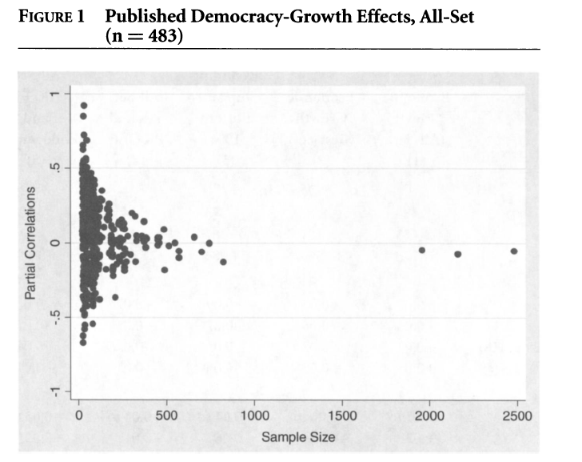
Democracies grow neither faster nor slower than dictatorships (controlling for other factors)
Source: Doucoullagos and Ulubasoglu (2008)

Slide 14
Do dictatorships grow faster or slower than democracies in poor countries?
Poor countries generally invest little (poverty trap)
Poor countries cannot afford a strong state to build roads, schools, etc. (weak capacity)
Labor force growth is high in poor countries generally
NO

Slide 15
Do dictatorships grow faster or slower than democracies in wealthy countries?
Wealthy dictatorships have
faster labor force growth (labor extensive)
lower wages (labor exploitative)
faster growth of capital stock
Wealthy democracies have
more technical progress
more efficient labor
better paid labor (allowed to unionize, strike, etc.)

Slide 16
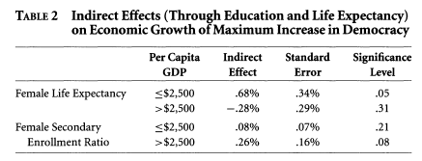
Democracies promote growth through greater investment in female health and education
Source: Baum and Lake 2003

Slide 17
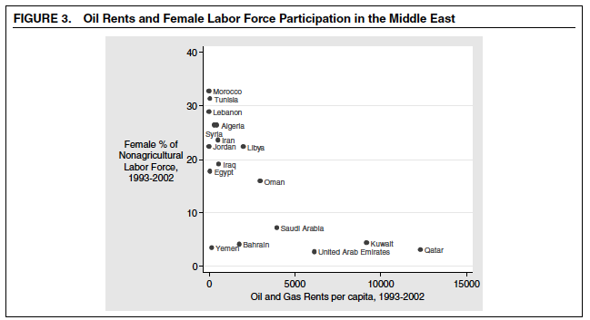
Whereas Communist dictatorships have high female labor force participation, oil rich dictatorships do not

Slide 18
What about the Tigers?
Although most long-term economic miracles were/are dictatorships …
E.g., South Korea, Singapore, Taiwan
Many short-term economic miracles fell into civil wars …
E.g., Ivory Coast, Yugoslavia, Yemen
And most disasters were/are dictatorships
E.g., Chad, Madagascar, Guyana

