Slide 1
Chloroplast
Nicole Feryzanitz
Esther Solis
Bio 4H
Dr. Shannon

Slide 2
Hartnell.edu

Slide 3
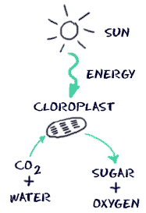
Functions
6 CO2+ 6 H2O → C6H12O6+ 6 O2
Carbon dioxide + Water + Light energy → Glucose + Oxygen
Biology4kids.com

Slide 4
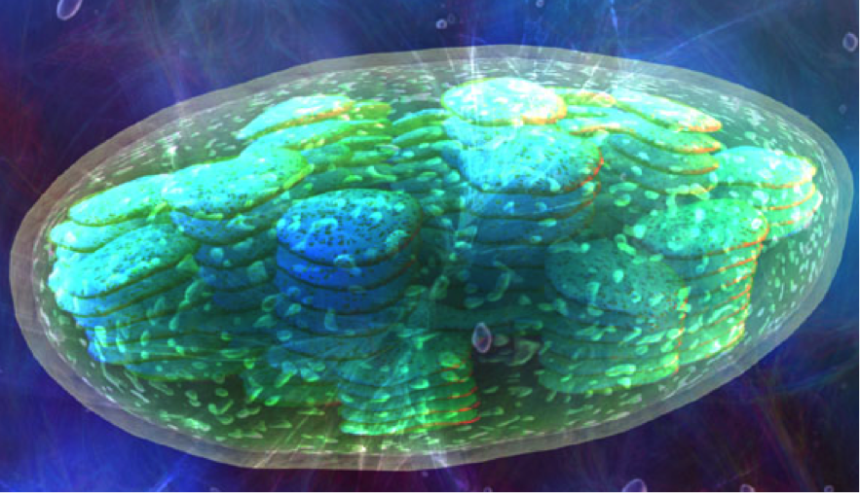
Chloroplast Structures
Inner/Outer Membrane
Membrane Space
Grana
Thylakoid Discs
Interconnecting Channels
Stroma
Starch Grain

Slide 5
Membranes
Outer- freely permeable to molecules
Inner- contains transporters that regulate passage in and out of chloroplasts
hyperphysics.phy-astr.gsu.edu

Slide 6
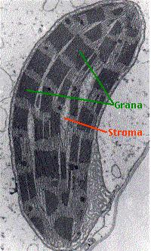
Stroma
Fluid surrounding Grana
Connects thylakoids from Grana

Slide 7
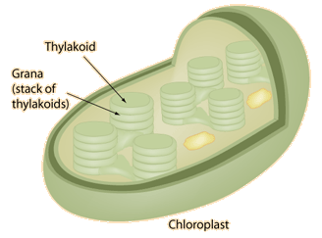
Grana
Stacks of Thylakoid Discs
Contains from 2-100 thylakoid discs
hyperphysics.phy-astr.gsu.edu

Slide 8
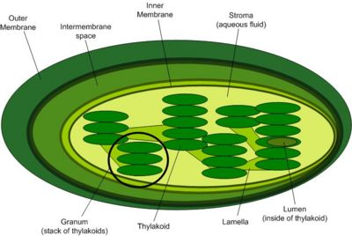
Thylakoid Discs
Disc shaped structures
Contain photosynthetic pigments
Interconnected and stacked on one another
Carry out Photosynthesis
cellbiology.med.unsw.edu.au
Notes:
Photons from sunlight hit the pigments, electrons are "knocked" loose, and off they go to energize the complicated process of photosynthesis
inside it (shown in yellow), is where the light or light-dependent reaction takes place. The so-called dark, or light independent reactions, take place in the stroma (shown in gray here).

Slide 9
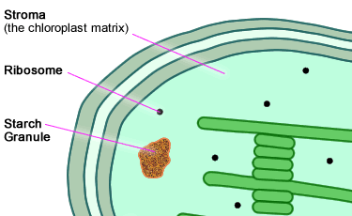
Starch Grain
Produced by photosynthesis
Store Glucose in form of Starch
http://www.ivy-rose.co.uk

Slide 10
Works Cited
Watson, David. "Exploring Photosynthesis in a Leaf - Chloroplasts, Grana, Stroma, Thylakoids, and Other Parts of a Leaf." FT Exploring Science and Technology Education. Flying Turtle, 2009. Web. 13 Sept. 2013.
Nave, R. "Chloroplasts." HyperPhysics Concepts. N.p., n.d. Web. 13 Sept. 2013.

