Slide 1
Metabolism: An overview
Ken Wu

Slide 2
Disclaimer
This tutorial is a simple and conceptual guide to metabolism
If there are any conflicts between my slides and the lecturers, THE LECTURER IS ALWAYS RIGHT…
…maybe not always but they set your exams so if in doubt, refer back to their teaching

Slide 3
Energy

Slide 4
The Three stages of Cellular Metabolism
Proteins
cytosol
NH₂
Amino Acids
TCA cycle
Oxidative
Phosphoryation
ATP
Pyruvate
Acetyl
CoA
Glucose
NADH
H₂0
NADH
ATP
Glycolysis
O₂
mitochondrion
Simple sugars
CO₂
Polysaccharides
Fatty Acids
&Glycerol
Fats
Courtesy of Dr James Pease

Slide 5
Glycolysis
Makes PYRUVATE
Needs ATP…
…but net gain of 2 ATP
By substrate-level phosphorylation
Also makes 2xNADH
For oxidative phosphorylation
Occurs in the Cytoplasm

Slide 6
The Fate of Pyruvate
Ethanol via acetaldehyde
Lactate
Via lactate dehydrogenase
Needs NADH
Regenerates NAD for glycolysis
Acetyl Co-A

Slide 7
Acetyl CoA synthesis
Pyruvate dehydrogenase complex
Generates Acetyl CoA, NADH
Occurs in the mitochondria matrix
3 Enzymes
Pyruvate decarboxylase
Lipoamide-reductase-transacetylase
Dihydrolipoyl dehydrogenase
5 Co-factors
FAD
NAD
CoA
Lipoamide
TPP

Slide 8
Pyruvate dehydrogenase complex
Pyruvate decarboxylase removes a carbon dioxide molecule from pyruvate
Results in an Acetyl group attached to the enzymes by the co-factors TPP and lipoamide
CoA is added to form 2 compounds
Acetyl CoA
Enzymes with co-factors attached
Enzymes and co-factors are then separated using NAD, forming
Original enzymes
Original co-factors
NADH

Slide 9
Krebs/TCA/Citric acid cycle
Each turn of the cycle:
Generates 3xNADH
Also generates 1xGTP, 1xFADH₂
Occurs in Matrix of Mitochondria

Slide 10
-ase, -ase, -ase…WTF!!!
Clue is in the name
Kinases phosphorylate stuff
Mnemonics do help
Glycolysis molecules:
Goodness gracious father Franklin did go by picking pumpkins prepare pies
Glycolysis enzymes:
Hot Poontang Practically Always Takes Great Patience Preparing Eventual Penetration
Krebs molecules:
Cindy is kinky so she fornicates more often
Krebs enzymes:
Corrupt Anti Intelligence Agent Spoke Slander For Money

Slide 11
Key enzymes
Hexokinase
Glucose – Glucose-6-phosphate
Isoform: glucokinase (Hexokinase IV)
In Liver, Low affinity for glucose, not easily inhibited
Pyruvate dehydrogenase complex

Slide 12
Key enzymes (cont’d)
Succinate dehydrogenase
On the inner membrane of the mitochondria
Communicated directly with ubiquinone
Succinate – Fumerate
Generates 1xFADH₂

Slide 13
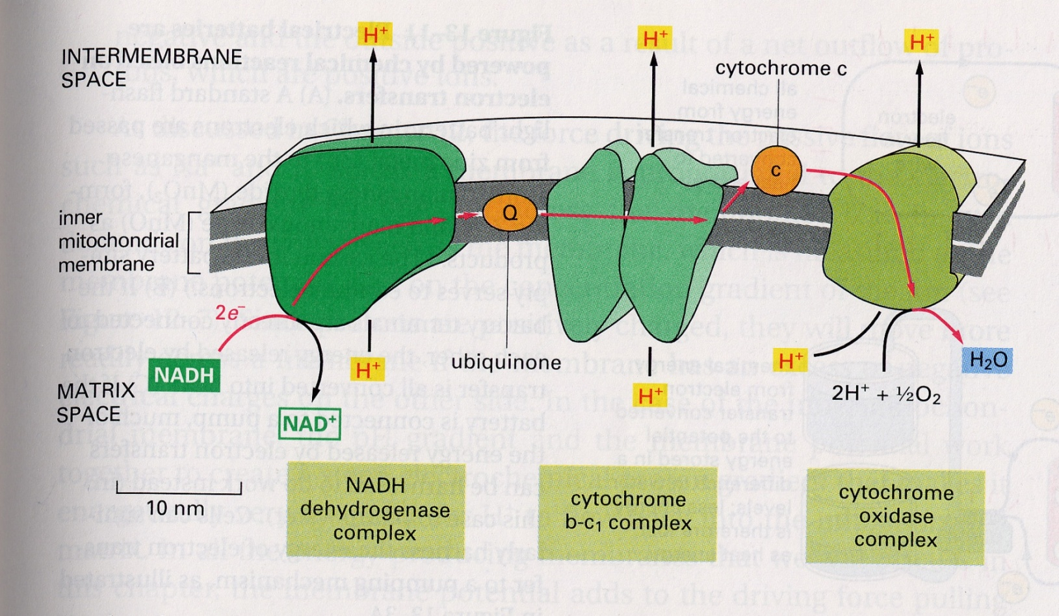
Oxidative phosphorylation
NUBCO

Slide 14
Demonstration!!!

Slide 15
Key points
3 membrane complexes
2 electron carriers
FADH₂ feeds into ubiquinone
Generates proton gradient
4e⁻ + 4H⁺ + O₂ 2H₂O

Slide 16
Chemiosmosis
Epic proton gradient generated
Protons diffuse across membrane via ATP Synthase
ATP Synthase
Membrane bound – 3 parts
In matrix – 3 parts
ATP generated

Slide 17
Oxidative vs substrate level phosphorylation
Substrate-level phosphorylation is the production of ATP by the direct transfer of a high-energy phosphate group from an intermediate substrate in a biochemical pathway to ADP, such as occurs in glycolysis.
Oxidative phosphorylation:
Electron transport chain, proton pump, needs oxygen
ATP generated by diffusions of protons down a gradient through an enzyme
Courtesy of Dr James Pease

Slide 18
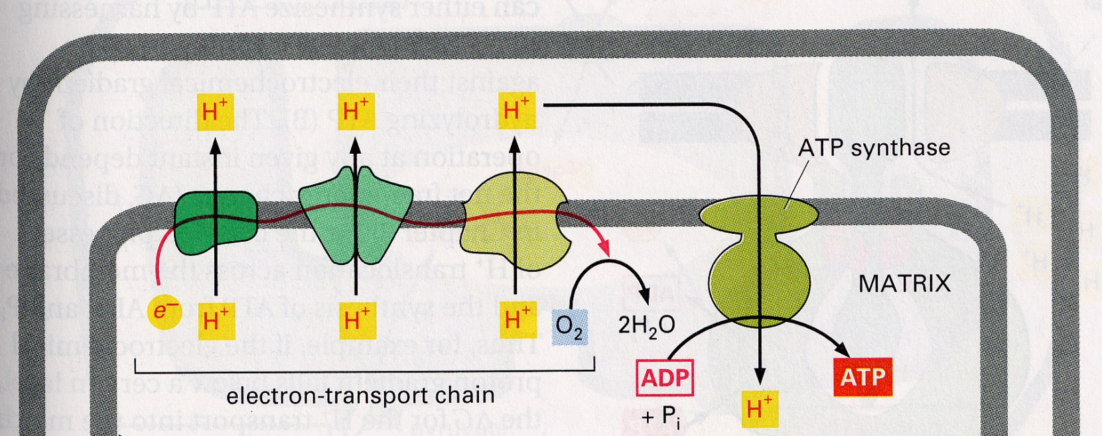
Metabolic Poisons
N₃⁻
CN-
CO
Oligomycin
Rotenone
DNP
H⁺
X
X
X
Courtesy of Dr James Pease

Slide 19
Fat metabolism
Fatty acids converted to Acyl CoA species
ATP converted to AMP
On outer mitochondrial membrane
Acyl CoA species transported to matrix by coupling it with Carnitine

Slide 20
β-oxidation
Oxidation, hydration, oxidation, then thiolysis
For every Acyl CoA species
Generates 1xNADH, 1xAcetyl CoA, 1xFADH₂
Fatty acid chain is reduced by 2 carbon atoms
Uses 1xH₂O
Occurs in Matrix of Mitochondria

Slide 21
Glucose Metabolism v Palmitate Metabolism
6 x ATP
Oxidative
Phosphoryation
PDH
2 x Acetyl
CoA
Glucose
NADH
38 x ATP
FAD
24 x ATP
Glycolysis
8 x ATP
TCA or Krebs cycle
Oxidative
Phosphoryation
Palmitate
8 x Acetyl
CoA
NADH
129 x ATP
35 x ATP
FAD
96 x ATP
β-oxidation
Have we forgotten anything?
TCA or Krebs cycle

Slide 22
Synthesis: un-metabolism
Gluconeogenesis
Done by different enzymes
uses ATP
Triglycerides: only glycerol can undergo gluconeogenesis, NOT FATTY ACIDS

Slide 23
Lipogenesis
Acetyl CoA is converted into Malonyl CoA by the enzyme Acetyl CoA carboxylase
ACP replaces CoA to generate Malonyl ACP
Another Acetyl CoA has its CoA replaced with ACP to form Acetyl ACP
Acetyl ACP condenses with Malonyl ACP to generate a 4C species – ACP and CO₂

Slide 24
Lipogenesis (cont’d)
Reduction, dehydration, reduction
Generates carbon chain – ACP
Further condensation with Malonyl ACP to lengthen the chain
Generates 2xNADP, 1xH₂O

Slide 25
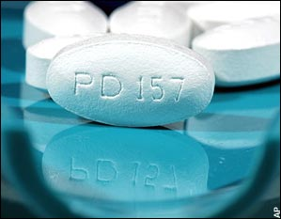
Cholesterol synthesis
3xAcetyl CoA combined to generate HMG-CoA
HMG CoA converted to mevalonate by HMG-CoA Reductase
HMG-CoA Reductase regulates synthesis of Mevalonate
This is the rate limiting step
Statins

Slide 26
Cholesterol synthesis (cont’d)
Mevalonate decarboxylated to form a 5 carbon species
Head to tail condensation reaction generates a 15 carbon species
2x 15 carbon species condense to form Squalene
Squalene is cyclised to form cholesterol
Uses NADPH

Slide 27
The Three stages of Cellular Metabolism
Proteins
cytosol
NH₂
Amino Acids
TCA cycle
Oxidative
Phosphoryation
ATP
Pyruvate
Acetyl
CoA
Glucose
NADH
H₂0
NADH
ATP
Glycolysis
O₂
mitochondrion
Simple sugars
CO₂
Polysaccharides
Fatty Acids
&Glycerol
Fats
Courtesy of Dr James Pease

Slide 28
Any questions?
Email me at ken.wu09@imperial.ac.uk
Visit the ICSM Year 1+2 past paper bank Facebook group
Good luck with the formative exam and MCD!

