Slide 1
Working Capital Management
Presenter’s name
Presenter’s title
dd Month yyyy

Slide 2
1. Introduction
Working capital management is the management of the short-term investment and financing of a company.
Goals:
  Adequate cash flow for operations
  Most productive use of resources
Internal and External Factors that Affect Working Capital Needs
Internal Factors | External Factors
Company size and growth rates Organizational structure Sophistication of working capital management Borrowing and investing positions/activities/capacities | Banking services Interest rates New technologies and new products The economy Competitors
Bottom line: There are many influences on a company’s need for working capital.
Notes:
LOS: Describe primary sources of liquidity and factors that influence a company’s liquidity position.
Page 304
Introduction
Working capital management is the management of the short-term investment and financing of a company.
Cash and cash equivalents, inventory, accounts receivable, accounts payable, short-term loans, etc.
The goals: Adequate cash flow for operations and the most productive use of resources.
Note: Too much cash may result in the company putting too much investment in low and nonearning assets.
Exhibit 8-1 Internal and External Factors that Affect Working Capital Needs
Internal factors:
Company size and growth rates
Organizational structure
Sophistication of working capital management
Borrowing and investing positions/activities/capacities
External factors:
Banking services
Interest rates
New technologies and new products
The economy
Competitors
Bottom line: There are many influences on a company’s need for working capital.

Slide 3
2. Managing and measuring Liquidity
Liquidity is the ability of the company to satisfy its short-term obligations using assets that are readily converted into cash.
Liquidity management is the ability of the company to generate cash when and where needed.
Liquidity management requires addressing drags and pulls on liquidity.
  Drags on liquidity are forces that delay the collection of cash, such as slow payments by customers and obsolete inventory.
  Pulls on liquidity are decisions that result in paying cash too soon, such as paying trade credit early or a bank reducing a line of credit.
Notes:
LOS: Describe primary sources of liquidity and factors that influence a company’s liquidity position.
LOS: Identify and evaluate the necessary tools to use in managing a company’s net daily cash position.
Pages 305–307
2. Managing and Measuring Liquidity
Liquidity is the ability of the company to satisfy its short-term obligations using assets that are readily converted into cash.
Note: We generally think of a company using current assets to satisfy current liabilities.
Liquidity management is the ability of the company to generate cash when and where needed.
Liquidity management requires addressing drags and pulls on liquidity.
Drags on liquidity are forces that delay the collection of cash, such as slow payments by customers and obsolete inventory.
Pulls on liquidity are decisions that result in paying cash too soon, such as paying trade credit early or a bank reducing a line of credit.

Slide 4
Sources of liquidity
Primary sources of liquidity
  Ready cash balances (cash and cash equivalents)
  Short-term funds (short-term financing, such as trade credit and bank loans)
  Cash flow management (for example, getting customers’ payments deposited quickly)
Secondary sources of liquidity
  Renegotiating debt contracts
  Selling assets
  Filing for bankruptcy protection and reorganizing.
Notes:
LOS: Describe primary sources of liquidity and factors that influence a company’s liquidity position.
Pages 305–306
Sources of Liquidity
Primary sources of liquidity
Ready cash balances (cash and cash equivalents)
Short-term funds (short-term financing, such as trade credit and bank loans)
Cash flow management (for example, getting customers’ payments deposited quickly)
Secondary sources of liquidity
Renegotiating debt contracts
Selling assets
Filing for bankruptcy protection and reorganizing.

Slide 5
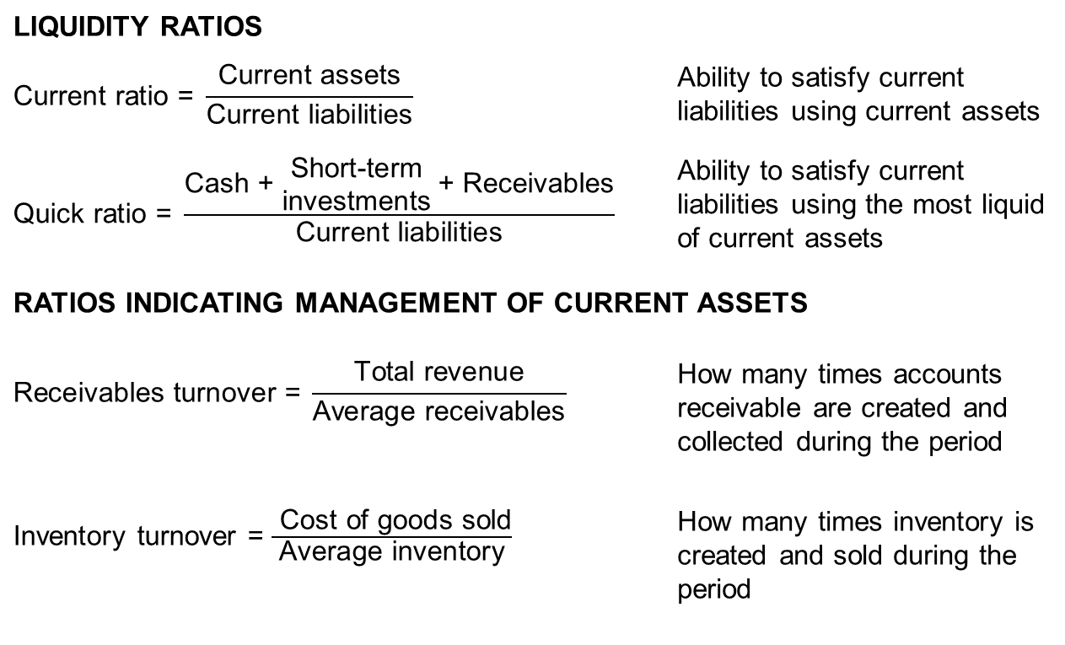
Measure of Liquidity
LIQUIDITY RATIOS
$$\text{Current} \text{ratio}\text{ = }\frac{\text{Current} \text{assets}}{\text{Current} \text{liabilities}}$$ |  | Ability to satisfy current liabilities using current assets
$$\text{Quick} \text{ratio}\text{ = }\frac{\text{Cash}\text{ + }\begin{matrix}\text{S}\text{hort}\text{−}\text{term} \\ \text{investments}\end{matrix} \text{+ }\text{Receivables}}{\text{Current} \text{liabilities}}$$ |  | Ability to satisfy current liabilities using the most liquid of current assets
RATIOS INDICATING MANAGEMENT OF CURRENT ASSETS
$$\text{Receivables} \text{turnover}\text{ =} \frac{\text{Total} \text{revenue}}{\text{Average} \text{receivables}}$$ |  | How many times accounts receivable are created and collected during the period
Inventory turnover = $\frac{ \text{Cost} \text{of} \text{goods} \text{sold}}{\text{Average} \text{inventory}}$ |  | How many times inventory is created and sold during the period
Notes:
LOS: Compare a company’s liquidity measures with those of peer companies.
Pages 307–309
Measure of Liquidity
Liquidity ratios
Current ratio: Ability to satisfy current liabilities using current assets
Quick ratio: Ability to satisfy current liabilities using the most liquid of current assets
Ratios indicating management of current assets
Receivables turnover: How many times accounts receivable are created and collected during the period
Inventory turnover: How many times inventory is created and sold during the period
Note: Dividing 365 by the turnover ratio results in the number of days.
Discussion question: Why does excluding inventory from the numerator in calculating the quick ratio provide a measure of liquidity different than the current ratio?

Slide 6
Operating and Cash Conversion Cycles
The operating cycle is the length of time it takes a company’s investment in inventory to be collected in cash from customers.
The net operating cycle (or the cash conversion cycle) is the length of time it takes for a company’s investment in inventory to generate cash, considering that some or all of the inventory is purchased using credit.
The length of the company’s operating and cash conversion cycles is a factor that determines how much liquidity a company needs.
  The longer the cycle, the greater the company’s need for liquidity.
Notes:
LOS: Evaluate working capital effectiveness of a company based on its operating and cash conversion cycles, and compare the company’s effectiveness with that of peer companies.
Page 312
Operating and Cash Conversion Cycles
The operating cycle is the length of time it takes a company’s investment in inventory to be collected in cash from customers.
The net operating cycle (or the cash conversion cycle) is the length of time it takes for a company’s investment in inventory to generate cash, considering that some or all of the inventory is purchased using credit.
The length of the company’s operating and cash conversion cycles is a factor that determines how much liquidity a company needs.
The longer the cycle, the greater the company’s need for liquidity.
Discussion questions: What type of companies would tend to have a long operating cycle? What type of companies would tend to have a short operating cycle?

Slide 7
Operating and Cash Conversion Cycles
Acquire Inventory for Cash
Sell Inventory for Credit
Collect on Accounts Receivable
Acquire Inventory for Credit
Sell Inventory for Credit
Collect on Accounts Receivable
Pay Suppliers
Operating Cycle
Cash Conversion Cycle
Notes:
LOS: Evaluate working capital effectiveness of a company based on its operating and cash conversion cycles, and compare the company’s effectiveness with that of peer companies.
Page 312
Operating and Cash Conversion Cycles
The cycle indicates the length of time that cash is invested in current assets (other than cash).
The cash conversion cycle is useful when the company acquires inventory using trade credit.
The length of time associated with a segment in the cycle varies among companies and industries.

Slide 8
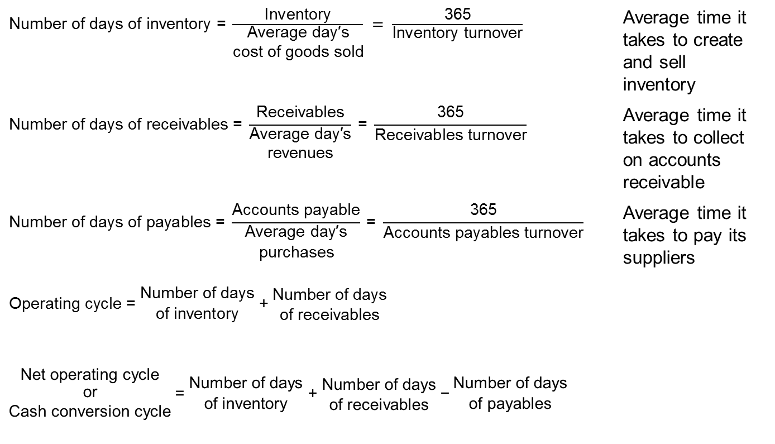
Operating and Cash Conversion Cycles: Formulas
$\text{Number} \text{of} \text{days} \text{of} \text{inventory}\text{ = }\frac{\text{Inventory}}{\begin{matrix}\text{A}\text{verage} \text{da}\text{y}\text{′}\text{s} \\ \text{cost} \text{of} \text{goods} \text{sold}\end{matrix}} = \frac{\text{365}}{\text{Inventory} \text{turnover}}$ |  | Average time it takes to create and sell inventory
$$\text{Number} \text{of} \text{days} \text{of} \text{receivables}\text{ = }\frac{\text{Receivables}}{\begin{matrix}\text{A}\text{verage} \text{da}\text{y}\text{′}\text{s} \\ \text{revenues}\end{matrix}} \text{= }\frac{\text{365}}{\text{Receivables} \text{turnover}}$$ |  | Average time it takes to collect on accounts receivable
$$\text{Number} \text{of} \text{days} \text{of} \text{payables}\text{ = }\frac{\text{Accounts} \text{payable}}{\begin{matrix}\text{A}\text{verage} \text{da}\text{y}\text{′}\text{s} \\ \text{purchases}\end{matrix}} \text{= }\frac{\text{365}}{\text{Accounts} \text{payables} \text{turnover}}$$ |  | Average time it takes to pay its suppliers
Operating cycle = $\begin{matrix}\text{N}\text{umber} \text{of} \text{days} \\ \text{of} \text{inventory}\end{matrix}\text{ +} \begin{matrix}\text{N}\text{umber} \text{of} \text{days} \\ \text{of} \text{receivables}\end{matrix}$
$$\begin{matrix}\text{N}\text{et} \text{operating} \text{cycle} \\ \begin{aligned}\text{or} \\ \text{Cash} \text{conversion} \text{cycle}\end{aligned}\end{matrix} \text{= }\begin{matrix}\text{N}\text{umber} \text{of} \text{days} \\ \text{of} \text{inventory}\end{matrix}\text{ + }\begin{matrix}\text{N}\text{umber} \text{of} \text{days} \\ \text{of} \text{receivables}\end{matrix} \text{−} \begin{matrix}\text{N}\text{umber} \text{of} \text{days} \\ \text{of} \text{payables}\end{matrix}$$
Notes:
LOS: Evaluate working capital effectiveness of a company based on its operating and cash conversion cycles, and compare the company’s effectiveness with that of peer companies.
Pages 309–312
Operating and Cash Conversion Cycles: Formulas
Number of days of inventory = Average time it takes to create and sell inventory
Number of days of receivables = Average time it takes to collect on accounts receivable
Number of days of payables = Average time it takes to pay its suppliers
Operating cycle = Number of days of inventory + Number of days of receivables
Net operating cycle or Cash conversion cycle = Numbers of days of inventory + Number of days of receivables – Number of days of payables

Slide 9
Example: Liquidity and Operating Cycles
Compare the liquidity and liquidity needs for
Company A and Company B for FY2:
 | Company A |  |  | Company B
 | FY2 | FY1 |  | FY2 | FY1
Cash and cash equivalents | €200 | €110 |  | €200 | €300
Inventory | €500 | €450 |  | €900 | €900
Receivables | €600 | €625 |  | €1,000 | €1,100
Accounts payable | €400 | €350 |  | €600 | €825
Revenues | €3,000 | €950 |  | €6,000 | €6,000
Cost of goods sold | €2,500 | €750 |  | €5,200 | €5,050
Notes:
LOS: Evaluate working capital effectiveness of a company based on its operating and cash conversion cycles, and compare the company’s effectiveness with that of peer companies.
Pages 307–312
Example: Liquidity and Operating Cycles
Company A Company B
FY2 FY1 FY2 FY1
Cash and cash equivalents €200 €110 €200 €300
Inventory €500 €450 €900 €900
Receivables €600 €625 €1,000 €1,100
Accounts payable €400 €350 €600 €825
Revenues €3,000 €950 €6,000 €6,000
Cost of goods sold €2,500 €750 €5,200 €5,050
The current asset accounts are used for the current ratio and the quick ratio. The revenues and cost of goods sold (COGS) are needed for the operating cycle calculations.
The FY1 data are needed because the calculation of purchases for the number of days payable requires beginning inventory:
Purchases = COGS + Ending inventory – Beginning inventory

Slide 10
Example: Liquidity and Operating Cycles
 | Company A |  |  | Company B
 | FY2 |  |  | FY2
Current ratio | 3.3 | times |  | 3.5 | times
Quick ratio | 2.0 | times |  | 2.0 | times
Number of days of inventory | 73.0 | days |  | 63.2 | days
Number of days of receivables | 73.0 | days |  | 60.8 | days
Number of days of payables | 57.3 | days |  | 42.1 | days
Operating cycle | 146.0 | days |  | 124.0 | days
Cash conversion cycle | 88.7 | days |  | 81.9 | days
How do these companies compare in terms of liquidity?
How do these companies compare in terms of their need for liquidity, based on their operating cycles?
Notes:
LOS: Evaluate working capital effectiveness of a company based on its operating and cash conversion cycles, and compare the company’s effectiveness with that of peer companies.
Pages 307–312
Example: Liquidity and Operating Cycles
Company B has slightly more liquidity than Company A (same quick ratio, but slightly higher current ratio, which means that Company B has a slightly greater proportion of inventory in its current assets compared with Company A).
Company A has a longer operating cycle (and cash conversion cycle) by approximately seven days.
Company B has a quicker turnover of inventory and receivables than Company A (that is, more efficient use).
Company B pays its trade creditors quicker than does Company A.

Slide 11
3. Managing the Cash Position
Management of the cash position of a company has a goal of maintaining positive cash balances throughout the day.
Forecasting short-term cash flows is difficult because of outside, unpredictable influences (e.g., the general economy).
Companies tend to maintain a minimum balance of cash (a target cash balance) to protect against a negative cash balance.
Examples of Cash Inflows and Outflows
Inflows Receipts from operations, broken down by operating unit, departments, etc. Fund transfers from subsidiaries, joint ventures, third parties Maturing investments Debt proceeds (short and long term) Other income items (interest, etc.) Tax refunds | Outflows Payables and payroll disbursements, broken down by operating unit, departments, etc. Fund transfers to subsidiaries Investments made Debt repayments Interest and dividend payments Tax payments
Notes:
LOS: Explain the effect of different types of cash flows on a company’s net daily cash position.
Pages 312–315
3. Managing the Cash Position
Management of the cash position of a company has a goal of maintaining positive cash balances throughout the day.
Forecasting short-term cash flows is difficult because of outside, unpredictable influences (e.g., the general economy).
Companies tend to maintain a minimum balance of cash (a target cash balance) to protect against a negative cash balance.
Exhibit 8-5. Examples of Cash Inflows and Outflows
Inflows
Receipts from operations, broken down by operating unit, departments, etc.
Fund transfers from subsidiaries, joint ventures, third parties
Maturing investments
Debt proceeds (short and long term)
Other income items (interest, etc.)
Tax refunds
Outflows
Payables and payroll disbursements, broken down by operating unit, departments, etc.
Fund transfers to subsidiaries
Investments made
Debt repayments
Interest and dividend payments
Tax payments

Slide 12
Managing cash
Managers use cash forecasting systems to estimate the flow (amount and timing) of receipts and disbursements.
Managers monitor cash uses and levels.
  They keep track of cash balances and flows at different locations.
A company’s cash management policies include
  Investment of cash in excess of day-to-day needs and
  Short-term sources of borrowing.
Other influences on cash flows:
  Capital expenditures
  Mergers and acquisitions
  Disposition of assets
Notes:
LOS: Explain the effect of different types of cash flows on a company’s net daily cash position.
Pages 315–316
Managing Cash
Managers use cash forecasting systems to estimate the flow (amount and timing) of receipts and disbursements.
See Exhibit 8-6 in the text for examples of systems of forecasting.
Note: The longer the term, the less precise the models.
Managers monitor cash uses and levels.
They keep track of cash balances and flows at all the different locations.
A company’s cash management policies include
Investment of cash in excess of day-to-day needs and
Short-term sources of borrowing.
Other influences on cash flows:
Capital expenditures
Mergers and acquisitions
Disposition of assets
Discussion question: Is it possible for a company to have too large a cash balance?

Slide 13
4. Investing Short-term Funds
Short-term investments are temporary stores of funds.
  Examples include U.S. Treasury Bills, eurodollar time deposits, repurchase agreements, commercial paper, and money market mutual funds.
Considerations:
  Liquidity
  Maturity
  Credit risk
  Yield
  Requirement of collateral
Notes:
LOS: Calculate and interpret comparable yields on various securities, compare portfolio returns against a standard benchmark, and evaluate a company’s short-term investment policy guidelines.
Pages 316–318
4. Investing Short-Term Funds
Short-term investments are temporary stores of funds.
Considerations:
Liquidity
Maturity
Credit risk
Yield
Requirement of collateral

Slide 14
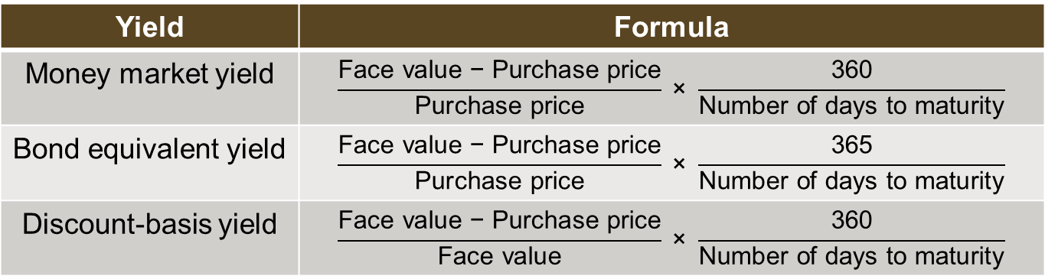
Yields on Short-Term Securities
The nominal rate is the stated rate of interest, based on the face value of the security.
The yield is the actual return on the investment if held to maturity.
There are different conventions for stating a yield:
Yield | Formula
Money market yield | $$\frac{\text{Face} \text{value}\text{ − }\text{Purchase} \text{price}}{\text{Purchase} \text{price}} \text{×} \frac{\text{360}}{\text{Number} \text{of} \text{days} \text{to} \text{maturity}}$$
Bond equivalent yield | $$\frac{\text{Face} \text{value}\text{ − }\text{Purchase} \text{price}}{\text{Purchase} \text{price}} \text{×} \frac{\text{365}}{\text{Number} \text{of} \text{days} \text{to} \text{maturity}}$$
Discount-basis yield | $$\frac{\text{Face} \text{value}\text{ − }\text{Purchase} \text{price}}{\text{Face} \text{value}} \text{×} \frac{\text{360}}{\text{Number} \text{of} \text{days} \text{to} \text{maturity}}$$
Notes:
LOS: Calculate and interpret comparable yields on various securities, compare portfolio returns against a standard benchmark, and evaluate a company’s short-term investment policy guidelines.
Page 318
Yields on Short-Term Securities
The nominal rate is the stated rate of interest, based on the face value of the security.
The yield is the actual return on the investment if held to maturity.
There are different conventions for stating a yield:
Money market yield $= \frac{\text{Face} \text{value}\text{ − }\text{Purchase} \text{price}}{\text{Purchase} \text{price}} \text{×} \frac{\text{360}}{\text{Number} \text{of} \text{days} \text{to} \text{maturity}}$
Bond equivalent yield = $\frac{\text{Face} \text{value}\text{ − }\text{Purchase} \text{price}}{\text{Purchase} \text{price}} \text{×} \frac{\text{365}}{\text{Number} \text{of} \text{days} \text{to} \text{maturity}}$
Discount-basis yield = $\frac{\text{Face} \text{value}\text{ − }\text{Purchase} \text{price}}{\text{Face} \text{value}} \text{×} \frac{\text{360}}{\text{Number} \text{of} \text{days} \text{to} \text{maturity}}$

Slide 15
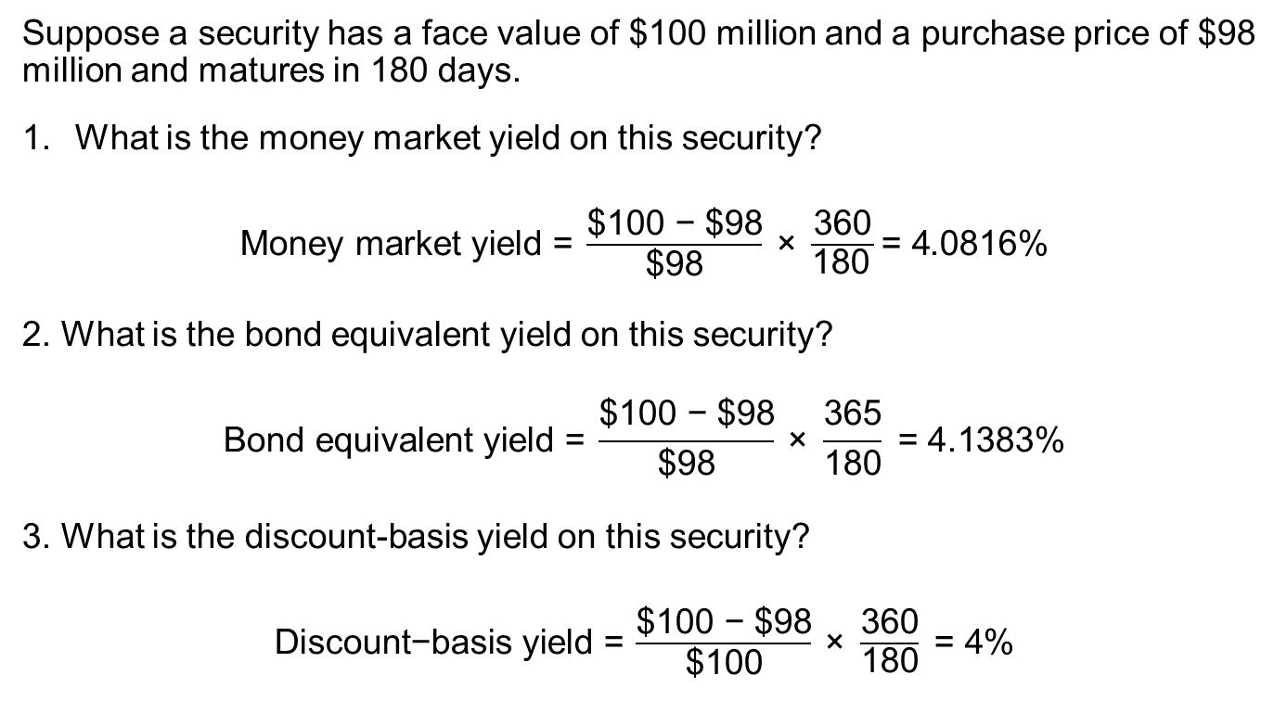
Example: Yields on
Short-term Instruments
Suppose a security has a face value of $100 million and a purchase price of $98 million and matures in 180 days.
What is the money market yield on this security?
$\text{Money} \text{market} \text{yield}\text{ = }\frac{\text{\$100 }\text{−}\text{ \$98}}{\text{\$98}} \text{×} \frac{\text{360}}{\text{180} }\text{= 4}$.0816%
2. What is the bond equivalent yield on this security?
$$\text{Bond} \text{equivalent} \text{yield}\text{ = }\frac{\text{\$100}\text{ −}\text{ \$98}}{\text{\$98}} \text{×} \frac{\text{365}}{\text{180}}\text{ = 4.1383\%}$$
3. What is the discount-basis yield on this security?
$\text{Discount}\text{−}\text{basis} \text{yield}\text{ =} \frac{\text{\$100}\text{ −}\text{ \$98}}{\text{\$100}} \text{×} \frac{\text{360}}{\text{180}}\text{ = 4}$%
Notes:
LOS: Calculate and interpret comparable yields on various securities, compare portfolio returns against a standard benchmark, and evaluate a company’s short-term investment policy guidelines.
Pages 316–318
Example: Yields on Short-Term Instruments
Suppose a security has a face value of $100 million and a purchase price of $98 million and matures in 180 days.
What is the money market yield on this security?
$\text{Money} \text{market} \text{yield}\text{ = }\frac{\text{\$100 }\text{−}\text{ \$98}}{\text{\$98}} \text{×} \frac{\text{360}}{\text{180} }\text{= 4}$.0816%
2. What is the bond equivalent yield on this security?
$$\text{Bond} \text{equivalent} \text{yield}\text{ = }\frac{\text{\$100}\text{ −}\text{ \$98}}{\text{\$98}} \text{×} \frac{\text{365}}{\text{180}}\text{ = 4.1383\%}$$
3. What is the discount-basis yield on this security?
$\text{Discount}\text{−}\text{basis} \text{yield}\text{ =} \frac{\text{\$100}\text{ −}\text{ \$98}}{\text{\$100}} \text{×} \frac{\text{360}}{\text{180}}\text{ = 4}$%

Slide 16
Short-term Investment Strategies
Short-Term Investment Strategies
Active
Passive
Matching Strategy
Mismatching Strategy
Laddering Strategy
Notes:
LOS: Calculate and interpret comparable yields on various securities, compare portfolio returns against a standard benchmark, and evaluate a company’s short-term investment policy guidelines.
Pages 320
Short-Term Investment Strategies
Active strategy
Matching strategy: Matching maturities with cash flows
Mismatching strategy: Intentionally mismatching maturities with cash flow timing to produce higher returns: riskier strategy
Laddering strategy: Spreading out maturities over time
Passive
Emphasizing safety and liquidity

Slide 17
Short-term Investment policy
Purpose
List and explain the reason the portfolio exists and describe general attributes.
Authorities
Describe the executives who oversee the portfolio managers (inside and outside) and describe what happens if the policy is not followed.
Limitations or Restrictions
Quality
Other Items
Describe the types of securities to be considered in the portfolio and any restrictions or constraints.
List the credit standards for holdings (for example, refer to short-term or long-term ratings).
Auditing and reporting may be included.
Notes:
LOS: Calculate and interpret comparable yields on various securities, compare portfolio returns against a standard benchmark, and evaluate a company’s short-term investment policy guidelines.
Pages 321–323
Short-Term Investment Policy
Items in short-term investment policy:
Purpose
List and explain the reason the portfolio exists and describe general attributes.
Authorities
Describe the executives who oversee the portfolio managers (inside and outside) and describe what happens if the policy is not followed.
Limitations or restrictions
Describe the types of securities to be considered in the portfolio, any restrictions or constraints.
Quality
List the credit standards for holdings (for example, refer to short-term or long-term ratings).
Other items
Auditing and reporting may be included.
Examples listed in Exhibit 8-9.
Evaluating a policy: (Example 8-3)
Is it effective?
Any potential shortcomings?
How could the policy be improved (if at all)?
Evaluating short-term fund management

Slide 18
5. Managing accounts Receivable
Objectives in managing accounts receivable:
  Process and maintain records efficiently.
  Control accuracy and security of accounts receivable records.
  Collect on accounts and coordinate with treasury management.
  Coordinate and communicate with credit managers.
  Prepare performance measurement reports.
Companies may use a captive finance subsidiary to centralize the accounts receivable functions and provide financing for the company’s sales.
Notes:
LOS: Evaluate a company’s management of accounts receivable, inventory, and accounts payable over time and compared to peer companies.
Pages 323–324
5. Managing Accounts Receivable
Objectives in managing accounts receivable:
Process and maintain records efficiently.
Control accuracy and security of accounts receivable records.
Collect on accounts and coordinate with treasury management.
Coordinate and communicate with credit managers.
Prepare performance measurement reports.
Companies may use a captive finance subsidiary to centralize the accounts receivable functions and provide financing for the company’s sales.
Example: Harley-Davidson Financial Services
Discussion question: Why would a company establish a captive finance subsidiary?

Slide 19
Evaluating the Credit function
Consider the terms of credit given to customers:
  Ordinary: Net days or, if a discount for paying within a period, discount/discount period, net days (for example, 2/10, net 30).
  Cash before delivery (CBD): Payment before delivery is scheduled.
  Cash on delivery (COD): Payment made at the time of delivery.
  Bill-to-bill: Prior bill must be paid before next delivery.
  Monthly billing: Similar to ordinary, but the net days are the end of the month.
Consider the method of credit evaluation that the company uses:
  Companies may use a credit-scoring model to make decisions of whether to extend credit, based on characteristics of the customer and prior experience with extending credit to the customer.
Notes:
LOS: Evaluate a company’s management of accounts receivable, inventory, and accounts payable over time and compared to peer companies.
Pages 324–325
Evaluating the Credit Function
Consider the terms of credit given to customers:
Ordinary: Net days or, if a discount for paying within a period, discount/discount period, net days (for example, 2/10, net 30).
Cash before delivery (CBD): Payment before delivery is scheduled.
Cash on delivery (COD): Payment made at the time of delivery.
Bill-to-bill: Prior bill must be paid before next delivery.
Monthly billing: Similar to ordinary, but the net days are the end of the month.
Consider the method of credit evaluation that the company uses:
Companies may use a credit-scoring model to make decisions of whether to extend credit, based on characteristics of the customer and prior experience with extending credit to the customer.

Slide 20
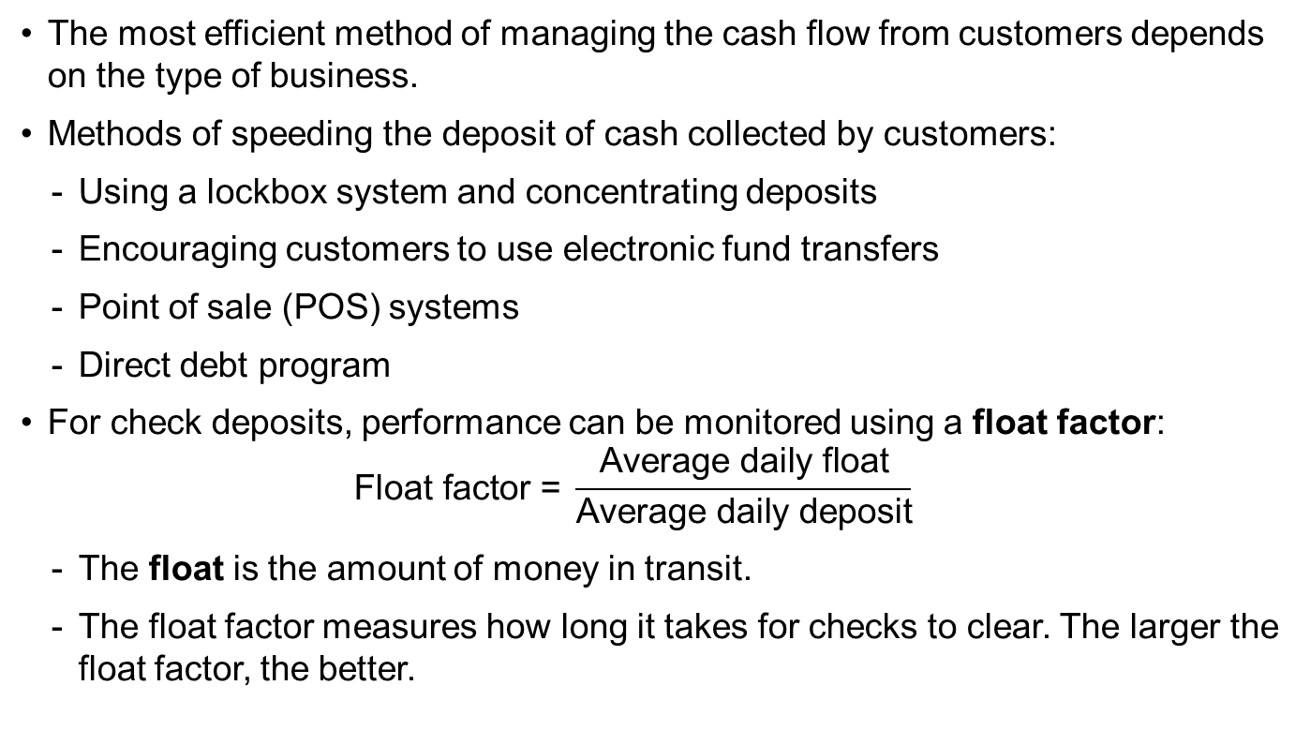
Managing Customers’ Receipts
The most efficient method of managing the cash flow from customers depends on the type of business.
Methods of speeding the deposit of cash collected by customers:
  Using a lockbox system and concentrating deposits
  Encouraging customers to use electronic fund transfers
  Point of sale (POS) systems
  Direct debt program
For check deposits, performance can be monitored using a float factor:
  $$\text{Float} \text{factor}\text{ = }\frac{\text{Average} \text{daily} \text{float}}{\text{Average} \text{daily} \text{deposit}}$$
  The float is the amount of money in transit.
  The float factor measures how long it takes for checks to clear. The larger the float factor, the better.
Notes:
LOS: Evaluate a company’s management of accounts receivable, inventory, and accounts payable over time and compared to peer companies.
Pages 326–328
Managing Customers’ Receipts
The most efficient method of managing the cash flow from customers depends on the type of business.
Methods of speeding the deposit of cash collected by customers:
Using a lockbox system and concentrating deposits
Encouraging customers to use electronic fund transfers
Point of sale (POS) systems
Direct debt program
For check deposits, performance can be monitored using a float factor:
$$\text{Float} \text{factor}\text{= }\frac{\text{Average} \text{daily} \text{float}}{\text{Average} \text{daily} \text{deposit}}$$
The float is the amount of money in transit.
The float factor measures how long it takes for checks to clear. The larger the float factor, the better.

Slide 21
Evaluating Accounts
Receivable Management
Aging schedule, which is a breakdown of accounts by length of time outstanding:
  Use a weighted average collection period measure to get a better picture of how long accounts are outstanding.
  Examine changes from the typical pattern.
Number of days receivable:
  Compare with credit terms.
  Compare with competitors.
Notes:
LOS: Evaluate a company’s management of accounts receivable, inventory, and accounts payable over time and compared to peer companies.
Pages 328–330
Evaluating Accounts Receivable Management
Aging schedule, which is a breakdown of accounts by length of time outstanding (Exhibit 8-12).
Use a weighted average collection period measure to get a better picture of how long accounts are outstanding.
Examine changes from typical pattern.
Number of days receivable:
Compare with credit terms.
Evaluate along with the aging schedule.
Compare with competitors.

Slide 22
6. Managing Inventory
The objective of managing inventory is to determine and maintain the level of inventory that is sufficient to meet demand, but not more than necessary.
Motives for holding inventory:
  Transaction motive: To hold enough inventory for the ordinary production-to-sales cycle.
  Precautionary motive: To avoid stock-out losses.
  Speculative motive: To ensure availability and pricing of inventory.
Approaches to managing levels of inventory:
  Economic order quantity: Reorder point—the point when the company orders more inventory, minimizing the sum of order costs and carrying costs.
  Just in time (JIT): Order only when needed, when inventory falls below a specific level
  Materials or manufacturing resource planning (MRP): Coordinates production planning and inventory management.
Bottom line: The appropriateness of an inventory management system depends on the costs and benefits of holding inventory and the predictability of sales.
Notes:
LOS: Evaluate a company’s management of accounts receivable, inventory, and accounts payable over time and compared to peer companies.
Pages 330–331
6. Managing Inventory
The objective of managing inventory is to determine and maintain the level of inventory that is sufficient to meet demand but not more than necessary.
Motives for holding inventory:
Transaction motive: To hold enough inventory for the ordinary production-to-sales cycle.
Precautionary motive: To avoid stock-out losses.
Stock-out losses are foregone sales as a result of insufficient inventory.
Speculative motive: To ensure availability and pricing of inventory.
Example: Gold or oil
Approaches to managing levels of inventory:
Economic order quantity: reorder point (EOQ-ROP): The point when the company orders more inventory, minimizing the sum of order costs and carrying costs.
May be modified with a safety stock (precautionary level of inventory).
See Exhibit 8-13 for pattern of use and ordering under EOQ-ROP.
Just in time (JIT): Order only when needed, when inventory falls below a specific level.
Materials or manufacturing resource planning (MRP): Coordinates production planning and inventory management.
Bottom line: The appropriateness of an inventory management system depends on the costs and benefits of holding inventory and the predictability of sales.

Slide 23
Evaluating Inventory Management
Measures
  Inventory turnover ratio.
  Number of days of inventory
When comparing turnover and number of days of inventory among companies, the analyst should consider the different product mixes among companies.
Notes:
LOS: Evaluate a company’s management of accounts receivable, inventory, and accounts payable over time and compared to peer companies.
Pages 332–333
Evaluating Inventory Management
Measures:
Inventory turnover ratio
Number of days of inventory
When comparing turnover and number of days of inventory among companies, the analyst should consider the different product mixes among companies.

Slide 24
7. Managing Accounts Payable
Accounts payable arise from trade credit and are a spontaneous form of credit.
Credit terms may vary among industries and among companies, although these tend to be similar within an industry because of competitive pressures.
Factors to consider:
  Company’s centralization of the financial function
  Number, size, and location of vendors
  Trade credit and the cost of alternative forms of short-term financing
  Control of disbursement float (i.e., amount paid but not yet credited to the payer’s account)
  Inventory management system
  E-commerce and electronic data interchange (EDI), which is the customer-to-business payment connection through the internet
Notes:
LOS: Evaluate a company’s management of accounts receivable, inventory, and accounts payable over time and compared to peer companies.
Pages 334–335
7. Managing Accounts Payable
Accounts payable arise from trade credit and are a spontaneous form of credit.
Credit terms may vary among industries and among companies, although these tend to be similar within an industry because of competitive pressures.
Factors to consider:
Company’s centralization of the financial function.
Number, size, and location of vendors
Trade credit and the cost of alternative forms of short-term financing
Control of disbursement float (i.e., amount paid but not yet credited to the payer’s account)
Inventory management system
E-commerce and electronic data interchange (EDI), which is the customer-to-business payment connection through the internet

Slide 25
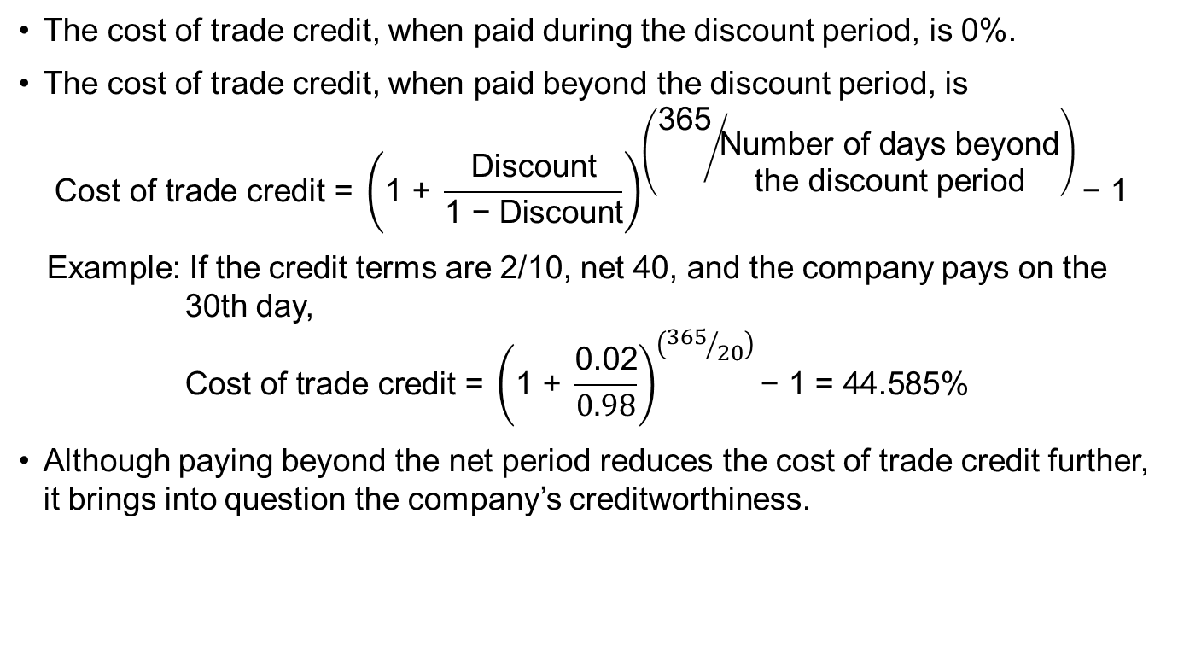
The Economics of Taking a
Trade Discount
The cost of trade credit, when paid during the discount period, is 0%.
The cost of trade credit, when paid beyond the discount period, is
$$\text{Cost} \text{of} \text{trade} \text{credit}\text{ = }{\left(\text{1} \text{+ }\frac{\text{Discount}}{\text{1 −} \text{Discount}}\right)}^{\left({\text{365}}/{\begin{matrix}\text{N}\text{umber} \text{of} \text{days} \text{beyond} \\ \text{the} \text{discount} \text{period}\end{matrix}}\right)}\text{− 1}$$
  Example: If the credit terms are 2/10, net 40, and the company pays on the 30th day,
  $$\text{Cost} \text{of} \text{trade} \text{credit}\text{ = }{\left(\text{1} \text{+} \frac{\text{0.02}}{\text{0.98}}\right)}^{\left({365}/{20}\right)}\text{−} \text{1}\text{ = 44.585\%}$$
Although paying beyond the net period reduces the cost of trade credit further, it brings into question the company’s creditworthiness.
Notes:
LOS: Evaluate a company’s management of accounts receivable, inventory, and accounts payable over time and compared to peer companies.
Pages 335–336
The Economics of Taking a Trade Discount
The cost of trade credit, when paid during the discount period, is 0%.
The cost of trade credit, when paid beyond the discount period, is
$$\text{Cost} \text{of} \text{trade} \text{credit}\text{ = }{\left(\text{1+ }\frac{\text{Discount}}{\text{1 −}\text{Discount}}\right)}^{\left({\text{365}}/{\begin{matrix}\text{N}\text{umber} \text{of} \text{days} \text{beyond} \\ \text{the} \text{discount} \text{period}\end{matrix}}\right)}\text{−1}$$
Similar to Example 8-6: If the credit terms are 2/10, net 40, and the company pays on the 30th day,
$$\text{Cost} \text{of} \text{trade} \text{credit}\text{ = }{\left(\text{1+ }\frac{\text{0.02}}{\text{0.98}}\right)}^{\left({365}/{20}\right)}\text{−} \text{1}\text{ = 44.585\%}$$
Although paying beyond the net period reduces the cost of trade credit further, it brings into question the company’s creditworthiness.
Discussion question: Is it ethical to intentionally stretch payments beyond the net period?

Slide 26
Evaluating accounts
Payable Management
The number of days of payables indicates how long, on average, the company takes to pay on its accounts.
We can evaluate accounts payable management by comparing the number of days of payables with the credit terms.
Notes:
LOS: Evaluate a company’s management of accounts receivable, inventory, and accounts payable over time and compared to peer companies.
Page 337
Evaluating Accounts Payable Management
The number of days of payables indicates how long, on average, the company takes to pay on its accounts.
We can evaluate accounts payable management by comparing the number of days of payables with the credit terms.
Also, compare number of days of payable with that of competitors.

Slide 27
8. Managing Short-term Financing
The objective of a short-term financing strategy is to ensure that the company has sufficient funds, but at a cost (including risk) that is appropriate.
Sources of financing (from Exhibit 8-15):
Bank Sources | Nonbank Sources
Uncommitted line of credit Regular line of credit Overdraft line of credit Revolving credit agreement Collateralized loan Discounted receivables Banker’s acceptances Factoring | Asset-based loan Commercial paper
Notes:
LOS: Evaluate the choices of short-term funding available to a company and recommend a financing method.
Pages 337–339
8. Managing Short-Term Financing
The objective of the short-term financing strategy is to ensure that the company has sufficient funds, but at a cost (including risk) that is appropriate.
Bank sources (from Exhibit 8-15):
Uncommitted line of credit (bank reserves the right to refuse to lend)
Regular line of credit (bank commits to lend)
Overdraft line of credit
Revolving credit agreement (revolvers): Similar to line of credit, but have formal agreement and longer period
Collateralized loan
Discounted receivables
Banker’s acceptances
Factoring
Nonbank sources (from Exhibit 8-15):
Asset-based loan: Secured finance company loan
Commercial paper

Slide 28
Which Short-term Financing?
Characteristics that determine the choice of financing:
  Size of borrower
  Creditworthiness of borrower
  Access to different forms of financing
  Flexibility of borrowing options
Asset-based loans are loans secured by an asset
Accounts Receivable
Blanket lien
Factoring
Inventory
Inventory blanket lien
Trust receipt arrangement
Assignment of accounts receivable
Warehouse receipt arrangement
Notes:
LOS: Evaluate the choices of short-term funding available to a company and recommend a financing method.
Pages 339–341
Which Short-Term Financing?
Characteristics that determine the choice of financing:
Size of borrower
Creditworthiness of borrower
Access to different forms of financing
Flexibility of borrowing options
Asset-based loans are loans secured by an asset.
Accounts receivable:
Blanket lien: Secured by current and future accounts
Assignment of accounts receivable: Secured by accounts
Factoring: Sold to factor, who then collects accounts
Inventory:
Inventory blanket lien: Inventory is security, but company can sell inventory as usual
Trust receipt arrangement: Inventory held in trust and any proceeds on sales go to lender
Warehouse receipt arrangement: Third-party supervises inventory (that is, the security for the loan)

Slide 29
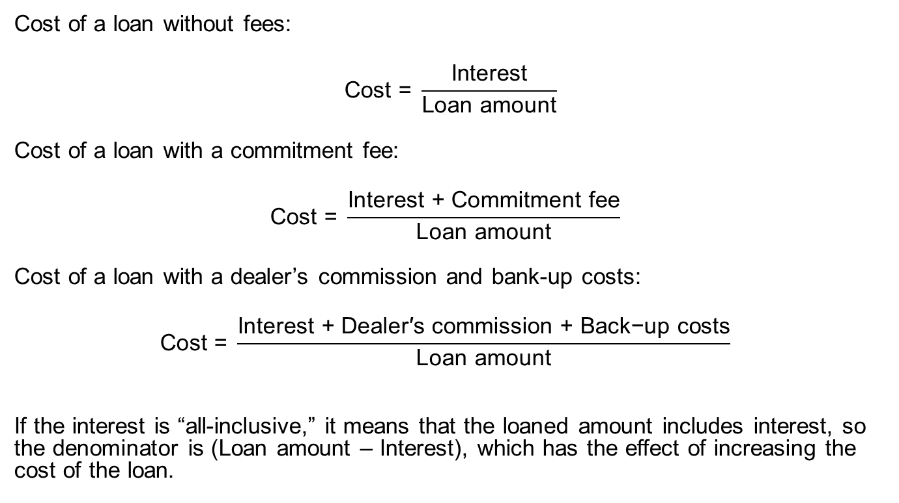
Costs of borrowing
Cost of a loan without fees:
$$\text{Cost}\text{ = }\frac{\text{Interest}}{\text{Loan} \text{amount}}$$
Cost of a loan with a commitment fee:
$$\text{Cost} \text{= }\frac{\text{Interest}\text{ + }\text{Commitment} \text{fee}}{\text{Loan} \text{amount}}$$
Cost of a loan with a dealer’s commission and bank-up costs:
$$\text{Cost} \text{= }\frac{\text{Interest} \text{+} \text{Dealer}\text{′}\text{s} \text{commission}\text{ + }\text{Back}\text{−}\text{up} \text{costs}}{\text{Loan} \text{amount}}$$
If the interest is “all-inclusive,” it means that the loaned amount includes interest, so the denominator is (Loan amount – Interest), which has the effect of increasing the cost of the loan.
Notes:
LOS: Evaluate the choices of short-term funding available to a company and recommend a financing method.
Pages 341–343
Costs of Borrowing
Cost of a loan without fees:
$$\text{Cost}\text{ = }\frac{\text{Interest}}{\text{Loan} \text{amount}}$$
Cost of a loan with a commitment fee:
$$\text{Cost} \text{= }\frac{\text{Interest}\text{ + }\text{Commitment} \text{fee}}{\text{Loan} \text{amount}}$$
Cost of a loan with a dealer’s commission and back-up costs:
$$\text{Cost} \text{= }\frac{\text{Interest} \text{+} \text{Dealer}\text{′}\text{s} \text{commission}\text{ + }\text{Back}\text{−}\text{up} \text{costs}}{\text{Loan} \text{amount}}$$
If the interest is “all-inclusive,” it means that the loaned amount includes interest, so the denominator is (Loan amount – Interest), which has the effect of increasing the cost of the loan.

Slide 30
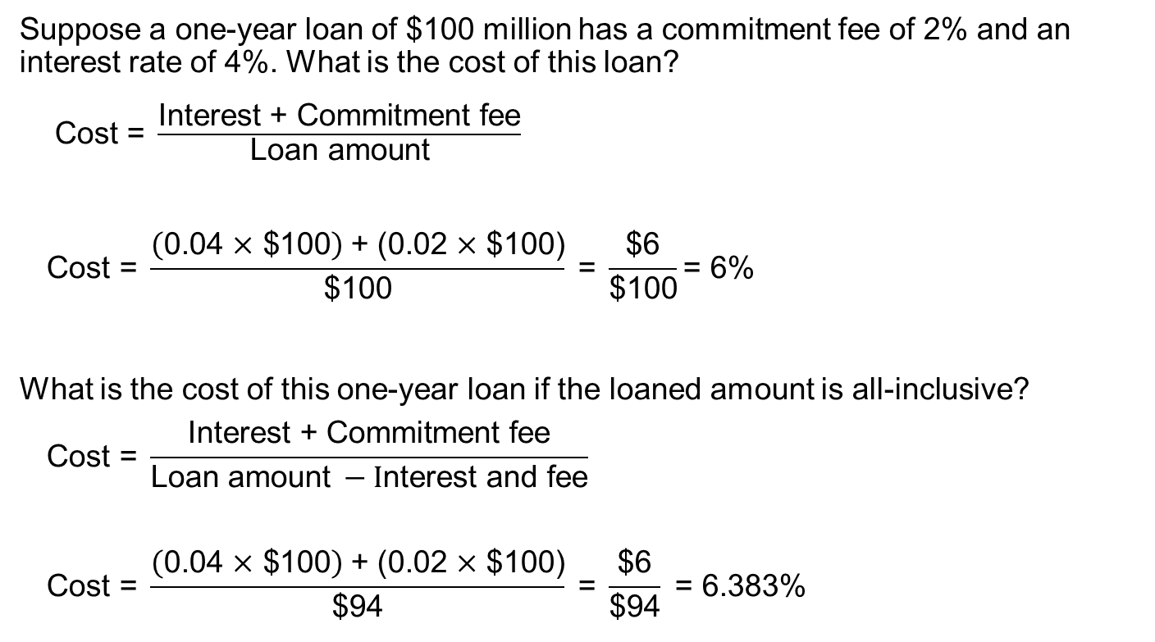
Example: Cost of Borrowing
Suppose a one-year loan of $100 million has a commitment fee of 2% and an interest rate of 4%. What is the cost of this loan?
  $\text{Cost} \text{= }\frac{\text{Interest} \text{+} \text{Commitment} \text{fee}}{\text{Loan} \text{amount}}$
  $$\text{Cost}\text{ = }\frac{\left(\text{0.04 }\text{×}\text{ \$100}\right) \text{+ (0.02 }\text{×}\text{ \$100)}}{\text{\$100}}\text{ = }\frac{\text{\$6}}{\text{\$100}}\text{= 6\%}$$
What is the cost of this one-year loan if the loaned amount is all-inclusive?
  $$\text{Cost} \text{= }\frac{\text{Interest} \text{+} \text{Commitment} \text{fee}}{\text{Loan} \text{amount} −\text{I}\text{nterest} \text{and} \text{fee}}$$
  $$\text{Cost}\text{ = }\frac{\left(\text{0.04 }\text{×} \text{\$100}\right) \text{+} \text{(0.02 }\text{×} \text{\$100)}}{\text{\$}\text{94}}\text{ = }\frac{\text{\$6}}{\text{\$94}} \text{=} \text{6}\text{.383}\text{\%}$$
Notes:
LOS: Evaluate the choices of short-term funding available to a company and recommend a financing method.
Pages 341–343
Example: Cost of Borrowing
Note: Examples are similar to the examples in Example 8-7.
Suppose a one-year loan of $100 million has a commitment fee of 2% and an interest rate of 4%. What is the cost of this loan?
$\text{Cost} \text{= }\frac{\text{Interest} \text{+} \text{Commitment} \text{fee}}{\text{Loan} \text{amount}}$
$$\text{Cost}\text{ = }\frac{\left(\text{0.04 }\text{×}\text{ \$100}\right)\text{+ (0.02 }\text{×}\text{ \$100)}}{\text{\$100}}\text{ = }\frac{\text{\$6}}{\text{\$100}} \text{= 6\%}$$
What is the cost of this one-year loan if the loaned amount is all-inclusive?
$$\text{Cost} \text{= }\frac{\text{Interest} \text{+} \text{Commitment} \text{fee}}{\text{Loan} \text{amount} −\text{Interest} \text{and} \text{fee}}$$
$$\text{Cost}\text{ = }\frac{\left(\text{0.04 }\text{×} \text{\$100}\right)\text{+} \text{(0.02 }\text{×} \text{\$100)}}{\text{\$}\text{94}}\text{ =} \frac{\text{\$6}}{\text{\$94}} \text{=} \text{6}\text{.383}\text{\%}$$
Note: If the loan is for less than one year, we would annualize the cost by the term of 365 divided by the number of days in the loan period.

Slide 31
9. Summary
Major points covered:
Understanding how to evaluate a company’s liquidity position.
Calculating and interpreting operating and cash conversion cycles.
Evaluating overall working capital effectiveness of a company and comparing it with that of other peer companies.
Identifying the components of a cash forecast to be able to prepare a short-term (i.e., up to one year) cash forecast.
Notes:
9. Summary

Slide 32
Summary (continued)
Understanding the common types of short-term investments and computing comparable yields on securities.
Measuring the performance of a company’s accounts receivable function.
Measuring the financial performance of a company’s inventory management function.
Measuring the performance of a company’s accounts payable function.
Evaluating the short-term financing choices available to a company and recommending a financing method.
Notes:
9. Summary

