Slide 1
Electromagnetism
SP5. Students will evaluate relationships between electrical and magnetic forces.
a. Describe the transformation of mechanical energy into electrical energy and the transmission of electrical energy.
d. Determine the relationship between moving electric charges and magnetic fields.

Slide 2
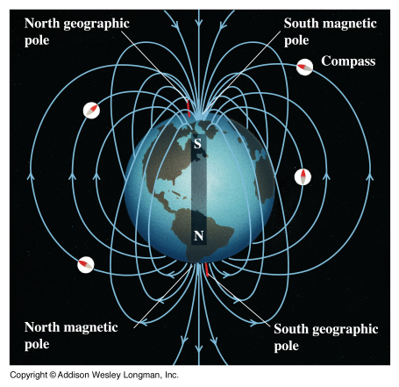
Magnetic Fields

Slide 3
Magnets can attract or repel other magnets.
They are able to exert forces on each other without touching because they are surrounded by magnetic fields.
Magnets have two different ends called poles, either north (N) or south (S).
Magnetic Flux refers to the density of the field lines.
Areas with many lines have strong magnetic fields.

Slide 4
It is important to note that magnetic fields are force fields and therefore we need to represent the lines as arrows.
In fact we define the direction of a magnetic field as the direction a compass would point in that field.
In a permanent magnet these lines go from north to south.

Slide 6
N S

Slide 7
We can sum up the behaviour of magnetic fields:
(1) Opposites attract
(2) Likes repel
This is very much like electric charges; however there is a very important difference between these two.
Electric charges can be singular charges (+ or -).
Whereas magnetic poles always exist in pairs.

Slide 8
Consider a compass:
A compass is useful because its needle always points north. This is because the needle is a magnet and so is the Earth.
Yeah fine, but WHY does it point north?
Well, the north pole of the compass will line up with the magnetic south pole of the Earth, which happens to be our geographic North Pole.

Slide 9
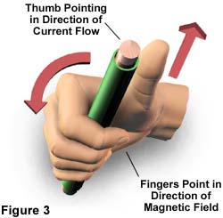
Well that’s all very well for magnetism, but where does the electro come in?
It turns out that any current carrying wire is surrounded by a magnetic field.
In fact a current carrying wire will have a very regular magnetic field around it as predicted by the:
1st Right Hand Rule:
Thumb: Direction of Current (+ to -)
Fingers: Direction of Magnetic Field

Slide 10
Often we will represent a current carrying wire simply as though you were looking at it end on. In this case we simply draw it as a circle. To indicate the direction of current flow we draw an (X) if it is in to the page and a (·) if it is out of the page.
If it helps to remember which is which think of an arrow!

Slide 11
Below shows current carrying wires (lines) and compasses (circles). Draw arrows to show which direction the compasses will point.

Slide 13
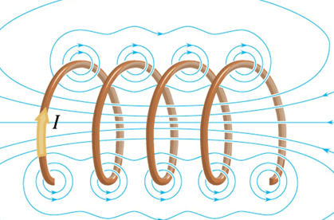
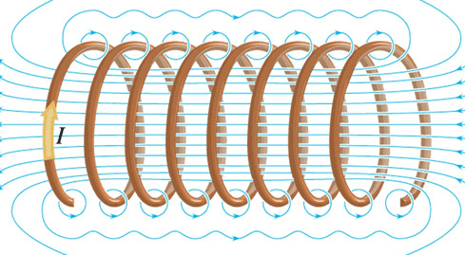
Solenoids: aka electromagnets
A solenoid is simply a coil of wire.
The many loops of wire each carry current and therefore their magnetic fields reinforce each other.

Slide 14
Just as with a bar magnet a solenoid has a north and south pole.
Note from the diagram that the field outside of a solenoid is weak and non-uniform especially if its width is much greater than its length.
However the magnetic field inside the solenoid is stronger and uniform (pointing from S to N).

Slide 15
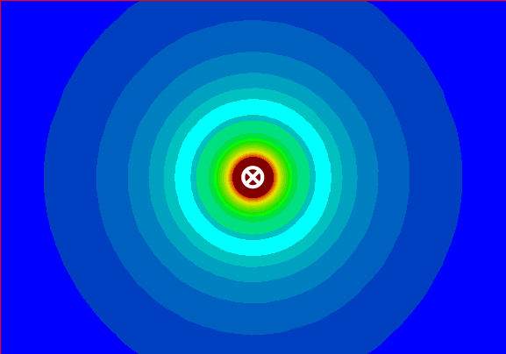
Magnetic Forces on Wires and Charges

Slide 16
With permanent magnets opposite poles attract and like poles repel.
As we have seen, magnetic fields surround any current carrying wire.
Therefore it stands to reason that magnetic forces will act on wires carrying electric current and charged particles moving in a magnetic field.

Slide 17
Parallel Current Carrying Wires
Picture two parallel wires carrying current in the same direction, would the fields produced by these wires attract or repel?
Parallel wires with current flowing in the same direction will attract each other.

Slide 18
The same logic can be used to determine how parallel wires containing currents the flow in the opposite direction interact.
Parallel wires with current flowing in the opposite directions will repel.

Slide 19
Moving Charges in Magnetic Fields
In the same way that charged particles moving through a wire will experience a force in a magnetic field, so will free charged particles.
Magnetic force is always applied perpendicular to the direction of the charge’s motion.
To determine the direction of the force on such a particle we simply use the RHR.

Slide 20
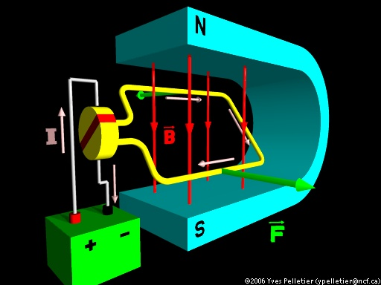
Motors

Slide 21
We have seen that a current carrying wire perpendicular to a magnetic field will experience a force.
This phenomenon is used by an electric motor to transform electrical energy into mechanical energy.
A simple DC motor consists of a loop of wire that passes through a magnetic field.

Slide 22
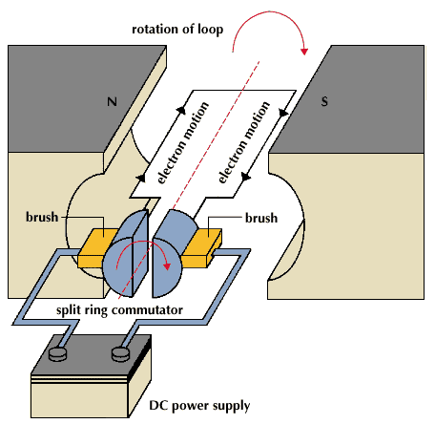
The commutator (split ring) is important because…
…it reverses the direction of current every half turn.

Slide 23
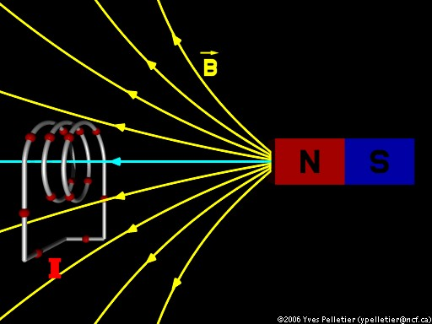
Electromagnetic
Induction

Slide 24
After scientists had discovered that an electric current can generate a magnetic field the logical question followed:
“If an electric current can generate a magnetic field, can a magnetic field generate an electrical current?”
Michael Faraday and Joseph Henry independently discovered they could.

Slide 25
Faraday discovered many ways to induce a current.
What was most interesting to note was that current is induced whether the magnet moves into the coil or the coil moves over the magnet.
This showed that magnetic fields do not simply create electric currents, rather they are only generated by changing magnetic fields.

Slide 26
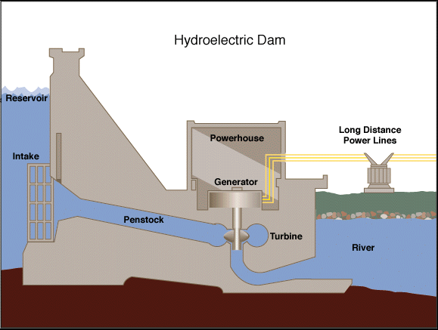
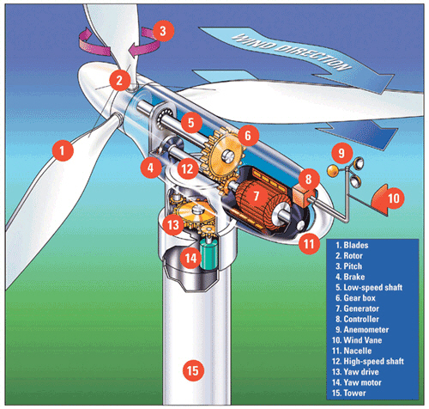
Devices that use mechanical energy to induce an electric current are called generators. Many kinds of mechanical energy can therefore by converted into electrical energy such as in: hydro-electric and wind turbines.

Slide 27
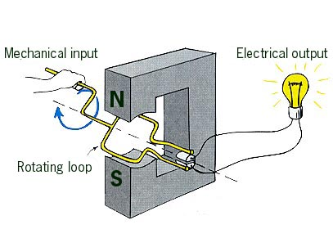
Note that these work in the exact opposite manner –
Motor: electrical energy to mechanical energy
Generator: mechanical energy to electrical energy
Generators produce alternating current because the direction of the current reverses every half turn.
So why do vehicles have an alternator?

Slide 28
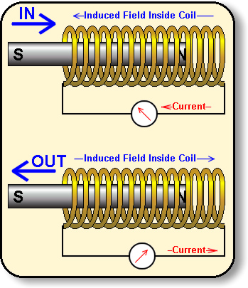
Another example of this comes when you move a bar magnet into or out of a hollow solenoid.
When the magnet is moved one way the current is in one direction and when it is moved the other way the current reverses.

Slide 29
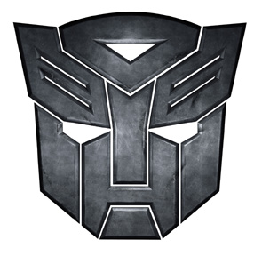
Transformers

Slide 30
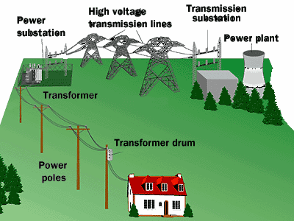
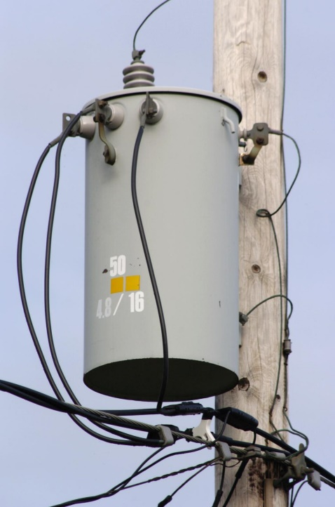
When we generate power we ramp up the voltage for transmission (up to 100000V) and then when it arrives at homes we ramp it back down for convenient use (120V).
Say we need to transmit a certain amount of power (P = IV)
a high voltage means a low current.
since power lost by the wire due to resistance is P_{loss} = I²R
low current means power loss is at a minimum

Slide 31
A transformer consists of a primary coil and a secondary coil.
As current flows through the primary coil it produces a magnetic field. This magnetic field then induces an electric current in the secondary coil.
Note that transformers generally only work when using alternating current. If we use direct current then we need to constantly switch the current on and off.

Slide 32
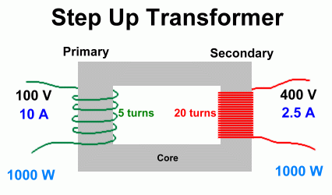
When a transformer increases voltage it is called a step-up transformer
Note that a step up transformer has…
…more secondary coils than primary.

Slide 33
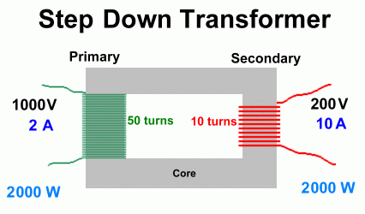
When a transformer decreases voltage it is called a step-down transformer
Note that a step up transformer has…
…more primary coils than secondary.

