Slide 1
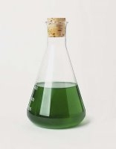
Algae as a Biofuel
Fall 2010
Advisors: Dr. Kauser Jahan Dr. William Riddell

Slide 2
Results Fall 2010
Using Algae as Fuel
Large Scale Algae Cultivation
Light Intensity Study
Nitrate Concentration Study
Future Work

Slide 3
Biofuels and Algae
Concern about global warming has increased focus on biofuels
Currently biofuels are primarily from food & oil products
Algae is a promising source of biofuel
ª For meeting 50% of all transport fuel needs of the United States.
^{b} 70% oil (by wt) in biomass.
^{c} 30% oil (by wt) in biomass.
Notes:
Mention that using food for feedstock causes competition with food crops=> prices go up
Algae is grown suspended in water=> requires less area to grow

Slide 4
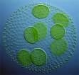
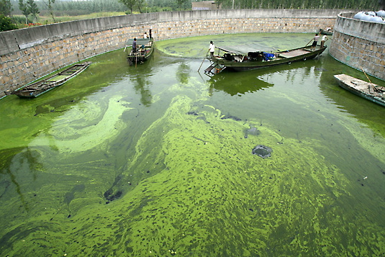
Characteristics of Algae
Simple cell structure facilitate rapid growth
Over 50,000 species, 30,000 have been studied
Adaptable to a variety of environments
High lipid yield
Chemical composition CO_{0.48}H_{1.83}N_{0.11} P_{0.01}
http://ucsdnews.ucsd.edu/thisweek/2008/01/images/photo-algae.jpg
http://images.businessweek.com/ss/08/05/0508_biofuels/image/algae.jpg
Notes:
Allow for growth in many conditions and climates
Can be promising for developing countries as well

Slide 5
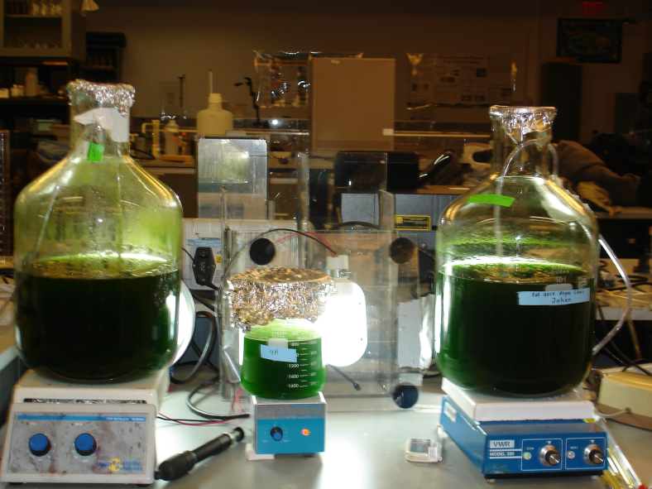
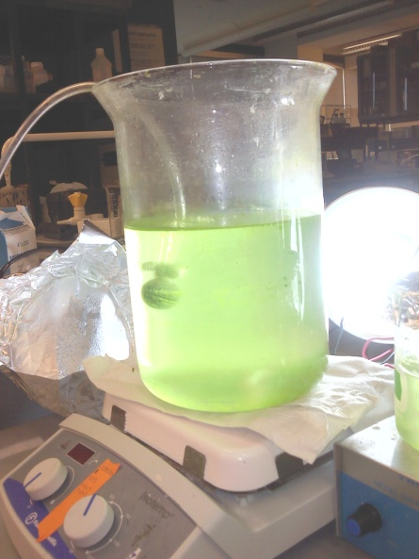
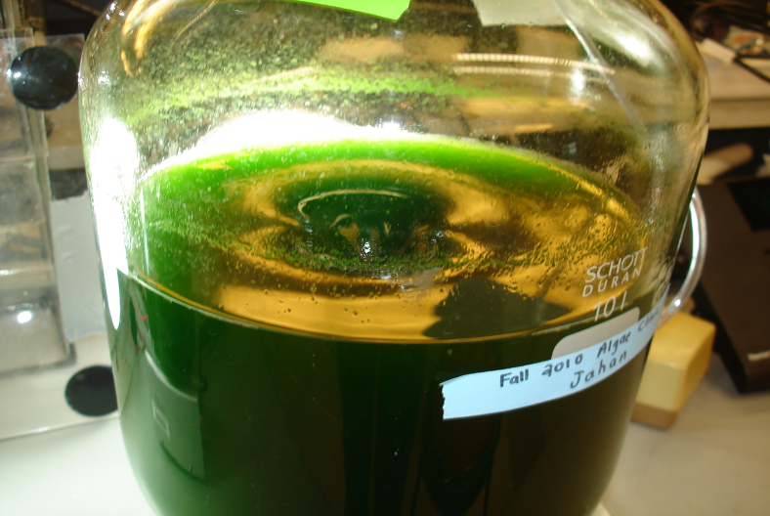
Important Factors for Algae Growth
Most Important
Light Intensity
CO2 Concentration
Nitrate Concentration
Other Factors
Temperature
pH
Agitation/Mixing

Slide 6
Scenedesmus dimorphus
Scenedesmus dimorphus is a unicellular bean shaped algae and 10 um in size.
This is one of the preferred species for oil yield, particularly for biodiesel.
Efficient in removal of nitrogen and phosphorus from wastewater-as such can also be used to treat wastewater and also for biodiesel source
Problems with Scenedesmus is that it is heavy, and forms thick sediments if not kept in constant agitation.
Protein 8-18% Carbohydrate 21-52% Lipid 16-40% Based on dry weight

Slide 7
Large Scale Algae Cultivation
2 vats, 5 – 12 Liters of Algae Culture
scenedesmus dimorphus
Temperature: 28 – 29° Centigrade
Light Intensity: 600 – 900 footcandles
Nitrate Concentration: 0.25 grams/Liter
Bold Basal’s Growth Medium
CO2 Concentration: ~2ppm
Constant aeration and stirring
Notes:
Mention that one vat contained algae from last semester, one contained new algae sample ordered from UTEX this semester

Slide 8
Light Intensity Experiments
Three light intensities studied
400, 600, and 800 foot candles
Two samples for each intensity
Second sample has twice the concentration of first sample
Samples isolated from outside light sources
Samples stirred at 85 – 100 RPM
Temperature, Optical Density, and pH recorded twice a week

Slide 9
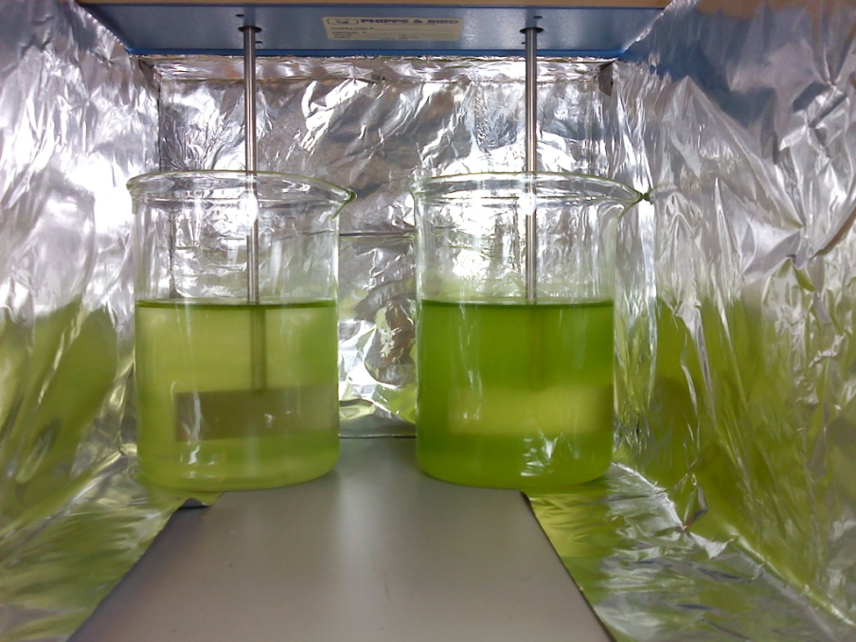
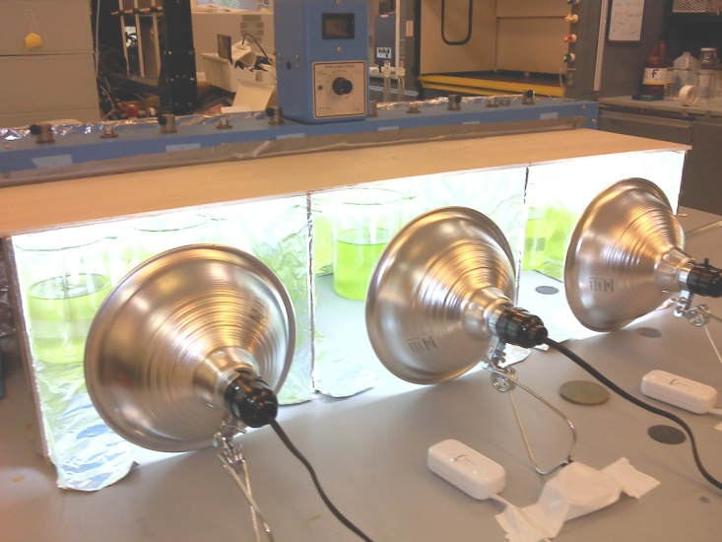
Light Intensity Setup

Slide 10
Light Intensity Growth Curves
Doubling Times
400 ft-c:
0.0643/day
600 ft-c:
0.0657/day
800 ft-c:
0.0559/day

Slide 11
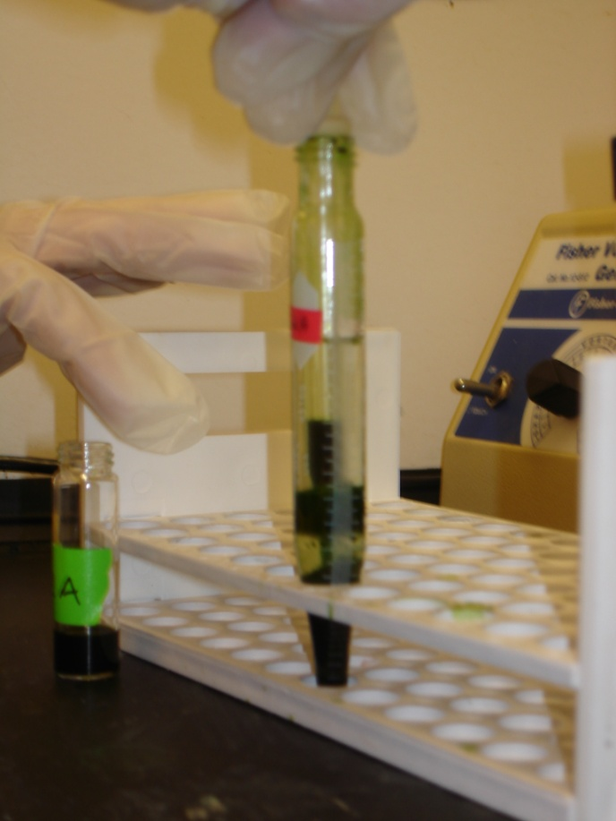
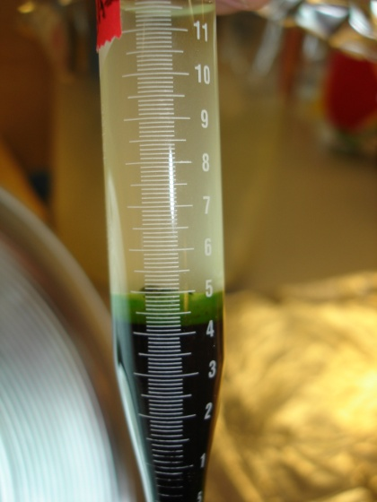
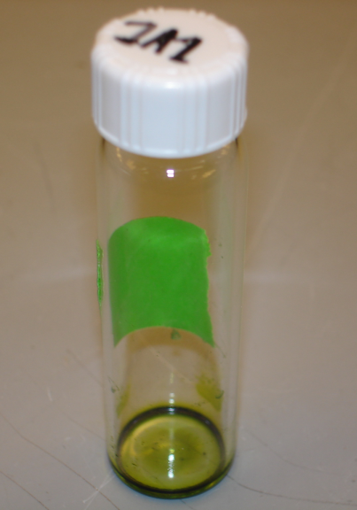
Light Intensity Lipid Yields
Bligh and Dyer Method of Lipid Extraction
 | Max Lipid Yield | Average Lipid Yield
400 ft-c | 24.60% | 13.26%
600 ft-c | 13.30% | 8.00%
800 ft-c | 14.56% | 10.60%

Slide 12
Nitrate Concentration Experiments
6 Samples
Ranging form 0.0 g/L to 0.5 g/L Nitrate, at 0.1 g/L intervals
Light Intensity: ~800 footcandles
Temperature: ~19 ° Centigrade
Stirred at 85 – 100 RPM
Temperature, Optical Density, and pH recorded twice a week
Study Still in Progress

Slide 13
Growth Curve For Nitrate Study
Doubling Times
Deficient:
0.090/day
0.1 g/L:
0.150/day
0.2 g/L:
0.127/day
0.3 g/L:
0.144/day
0.4 g/L:
0.147/day
0.5 g/L:
0.078/day

Slide 14
Conclusions about Scenedesmus Dimorphus
Light Intensity Study:
Optimum Light Intensity 400 ft-c to 600 ft-c
Since growth rates are similar=>More economic to use 400 ft-c
Excess exposure to light is detrimental to growth rate and lipid yield
Nitrate Concentration Study:
Optimum Nitrate Concentration between 0.1 g/L and 0.4 g/L
Nitrogen from atm diffuses into solution in Deficient Solution
Excess Nitrate also seems to be detrimental to algae growth
Study still underway

Slide 15
Future Work
Complete Nitrate Concentration Study
Work with Chemistry Department to improve Lipid Extraction Techniques
Mixed Culture Studies
CO2 concentration studies
Research various methods of CO2 delivery

Slide 16
Future Work Continued
Develop Models to Predict Growth Rate and Lipid Content
Microalga Scenedesmus obliquus as a potential source for biodiesel production (Mandal & Mallick, 2009)

Slide 17
Questions?

Slide 18
Bold Basal’s Growth Medium

