Slide 1
Energy versus exergy: An empirical analysis of thermodynamic metrics at the macro scale
ISIE-ISSST 2017: Science in Support of Sustainable and Resilient Communities, 25th – 29th June 2017
Samuel Cooper, Jonathan Norman, Geoff Hammond
University of Bath, Bath UK
sjgcooper@bath.edu
EPRSC grant: EP/N022645/1
Data available at:
https://doi.org/10.15125/BATH-00378
Notes:
Happy with whatever author order and contact info you prefer.
NB data doi not quite live yet – might remove but figure it could be useful hook for people interested in future.

Slide 2
Exergy and Improvement Potential
Energy can’t be destroyed but it can be degraded
Exergy is a measure that takes this into account. It is the work that can theoretically be done by that energy.
Improvement potential gives theoretical limit to improvement that could be achieved
Application in analysis of energetic systems.
Energy versus exergy: An empirical analysis of thermodynamic metrics at the macro scale
ISIE-ISSST 2017: Science in Support of Sustainable and Resilient Communities, 25th – 29th June 2017
Notes:
(Starting by introducing exergy and improvement potential before outlining 3 topics investigated in this research)
Exergy analysis is useful tool for analysing processes – especially those with energy as “output”.
There is a theoretical basis for exergetic improvement potential, we have used it in this way (e.g. Geoff since 1999) but real systems at sector / economy scale are complex and have a lot of varied constraints.
This raises the questions - How meaningful actually is exergy analysis at this scale? How can it be best applied?

Slide 3
What about large scale?
Two questions examined empirically:
Has the Improvement Potential of sectors been a good indicator of the efficiency improvement that actually then took place?
How sensitive are results to the selection of boundaries and definitions? Comparing exergy efficiency and exergy productivity.
How can exergy be usefully applied, where might there be problems in over-relying on it?
Energy versus exergy: An empirical analysis of thermodynamic metrics at the macro scale
ISIE-ISSST 2017: Science in Support of Sustainable and Resilient Communities, 25th – 29th June 2017
Notes:
“How useful is exergy at macro scale?” is a big, open ended question. We’re focussing on three aspects relating to the use of exergy to assess the improvement potential.
Could also note that although proponents of exergy suggest it is a good proxy for environmental burden (either directly or by measuring the exergy that would be required to restore a system) or a proxy for difficulty in obtaining scarce materials, empirically it seems that the correlations are very weak.

Slide 4
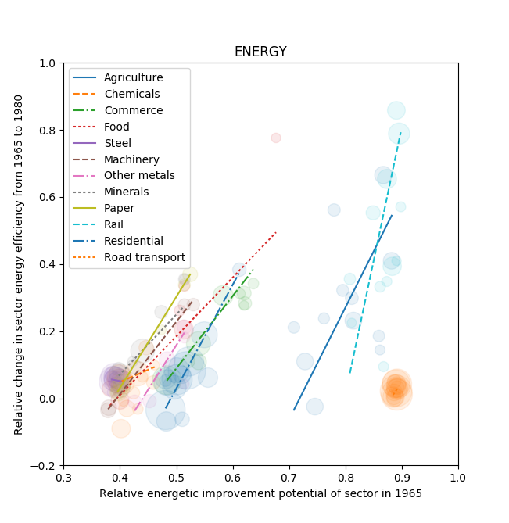
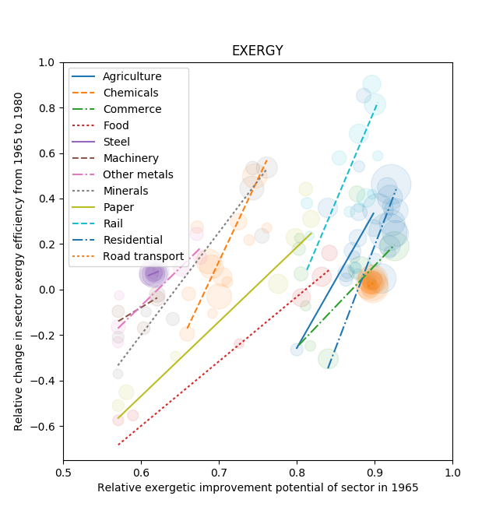
Improvement Potential and actual improvement
Compared exergy efficiency of industrial sectors in EU-15* to efficiency improvement that took place in following 15 years.
Was energy or exergy a better predictor?
* Based on methodology in: A. C. Serrenho, T. Sousa, B. Warr, R. U. Ayres, and T. Domingos, “Decomposition of useful work intensity: The EU (European Union)-15 countries from 1960 to 2009,” Energy, vol. 76, pp. 704–715, 2014.
Energy versus exergy: An empirical analysis of thermodynamic metrics at the macro scale
ISIE-ISSST 2017: Science in Support of Sustainable and Resilient Communities, 25th – 29th June 2017
Notes:
There are several reasons that we might see this relationship at scale – actual processes improving, more opportunities for substitution, more economic drivers for change (e.g. less efficient factories being replaced).
We can see some positive correlation between improvement potential and actual savings that took place, when considering both exergy and energy. How good are these fits?

Slide 5
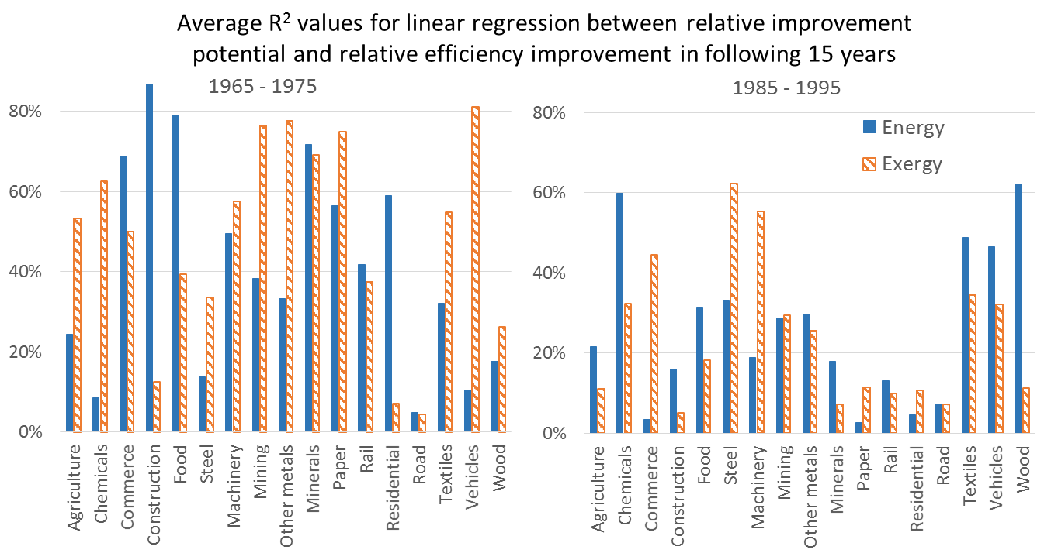
Improvement Potential and actual improvement
Varied results for both metrics – variation between sectors and with time.
Energy versus exergy: An empirical analysis of thermodynamic metrics at the macro scale
ISIE-ISSST 2017: Science in Support of Sustainable and Resilient Communities, 25th – 29th June 2017
Notes:
Could use other metrics to determine relationship / fit. However, this is useful straightforwards way to illustrate that for different sectors each metric (energy & exergy) is sometimes better or worse than each other and sometimes both are good / poor.
Reminder that R^2 can be interpreted as the extent to which the variation in improvement can be explained by differences in the initial improvement potential.
We could hypothesis some of the reasons for the different relationships. E.g. perhaps it is general shift of a technology (e.g. transition to condensing gas boilers). If economic (or other) constraints mean that the technology can’t change dramatically then the energy efficiency may be a better indicator (e.g. as a gas boiler can’t get much more efficient), but then in times when transition of technologies occur then perhaps exergy is a better indicator. Hard to know which in advance, however.
However, the main point is the large variation and that in some cases the better predictor for the first period is not the best for the later period

Slide 6
Comparing exergy efficiency and productivity
Sectoral output typically can’t be defined objectively as energy (i.e. a “product exergy content”)
“Useful exergy” is used as a proxy. E.g. high temperature heat supplied to a process or motive power supplied to car tyres.
However, this is not entirely objective – there is a balance between having a meaningful exergy content and this exergy being related to the desired output of the sector.
Transport example:
>
>
>
>
To assess whether the points for measuring useful exergy are consistent, we would ideally compare to the minimum theoretical exergy content of the desired product / output but this isn’t generally feasible so we compare exergy efficiency to exergy productivity.
Exergy efficiency = “Useful exergy” used by sector / Exergy inputs to sector
Exergy productivity = Monetary value of sector outputs / Exergy inputs to sector
Consistent ratio implies strong correlation between value and product exergy AND useful exergy well correlated with product exergy.
Energy versus exergy: An empirical analysis of thermodynamic metrics at the macro scale
ISIE-ISSST 2017: Science in Support of Sustainable and Resilient Communities, 25th – 29th June 2017
Notes:
Transport example: Work developed by engine could be taken as “useful work”. Or, the work actually transmitted to the tyres. Moving closer to the actual desired service of the sector but further away from a clearly defined energy content, we could instead consider the sum of the potential and kinetic energy gains made by the laden truck as it goes up hill or accelerates. Or, the share of these gains that is due to the goods being transported. Or, the share of this that is due to the goods than need to be transported (e.g. if an optimised route or loading option were available, or if the need for the goods to be transported could be met in another way). With each step, we reduce the exergy “content” / minimum requirement but move closer to the actual need being satisfied using that energy.
Air conditioning example also works, e.g. electricity supplied to motor > motive power supplied to compressor > exergy of cold air > exergy of cold air in useful locations / times
So there’s a gap, how much is it? We can’t determine it directly, but sectors try to provide a good or service, so to what extent does the exergy that is “usefully used” actually relate to the ££ output? This will show whether there is a consistent gap.

Slide 7
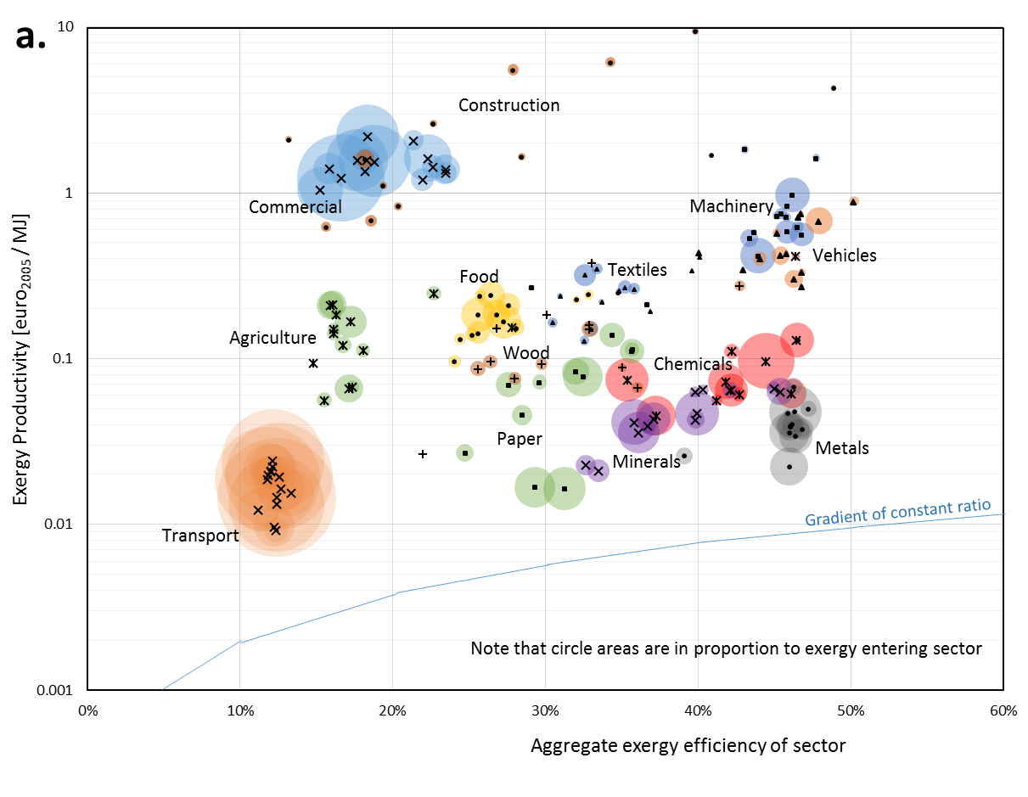
Comparing exergy efficiency and productivity
Energy versus exergy: An empirical analysis of thermodynamic metrics at the macro scale
ISIE-ISSST 2017: Science in Support of Sustainable and Resilient Communities, 25th – 29th June 2017
Notes:
There is large variation overall (more in the productivity which is log scale)
There is not a clear relationship where both increase together.
There is also significant variation between the “same” sectors in different nations. It may be that the product / service supplied by the “same” sector in different nations is significantly different. However, this also adds question over the idea that simple exergy comparisons are really meaningful at this level of aggregation (i.e. if the products can’t be substituted then the idea that they should tend towards the most efficient option is less robust).
Hard to make the case that useful exergy relates to “value” in any universal way.
Main point is that the “gap” between the use of “useful exergy” and the value of the outputs varies hugely. This implies different scope for intervention that isn’t covered by scope of sector level exergy analysis.
Other studies note need for consistent definitions (e.g. AC / motor). However, here we also suggest that it’s not just random changes in the results but rather that there is a systematic effect where more detail (i.e. the definition of the “useful exergy” gets closer to the actual service provided – e.g. Air Con rather than just motor being driven) results in lower exergy efficiency being calculated.
If this suggestion is true, then we would expect the results to have constant exergy productivity while exergy efficiency varies – that is, the efficincty variation is offset by opposite change in “useful exergy to value of output” ratio. While for each sector a constant efficiency:productivity ratio is seen.
In fact, the results don’t support this very well but support it better than the idea that the ratio is fixed across all sectors.

Slide 8
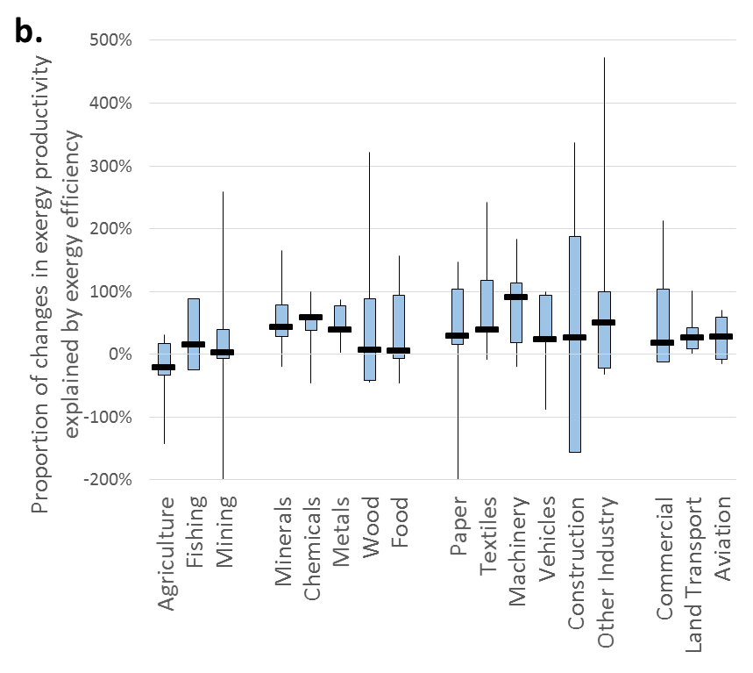
Comparing exergy efficiency and productivity
Energy versus exergy: An empirical analysis of thermodynamic metrics at the macro scale
ISIE-ISSST 2017: Science in Support of Sustainable and Resilient Communities, 25th – 29th June 2017
Notes:
This is the extent to which year-on-year improvements in exergy efficiency can explain improvements in exergy productivity.
(averaged over 15 year period, with variation showing quartiles – weighted by exergy inputs – across EU15 nations)
i.e. if the efficiency doubles then if nothing else changes, half as much energy input would be required to deliver same energy use so the exergy productivity would also double. All of the exergy productivity improvement is explained by the efficiency improvement.
However, we see that in most cases, the improvements in exergy efficiency actually explain only around 50% of the exergy productivity improvements. i.e. other changes that occur between the delivery of the “useful exergy” and how it is used to supply the product that has value, are about as significant.
So, the improvements in exergy efficiency are significant but just not the whole story.
It is also noteworthy that there is a large range with many examples being either negative or greater than 100%. In these cases, there must be significant other changes occurring and so trying to compare exergy efficiencies across them is definitely apples and pears.

Slide 9
Conclusions
Exergy analysis can be useful at the macro scale
It should not be exclusively relied on. Energy analysis and other metrics specific to research questions are also relevant.
There are many factors influencing improvement in energy and exergy efficiency. The exergetic (and energetic) improvement potential is one of these but other constraints and technological limits apply.
System boundary issues still exist surrounding the measurement of “useful” exergy.
Care must be taken so that focus on exergy does not underplay options such as resource efficiency or more intelligent use of energy.
Energy versus exergy: An empirical analysis of thermodynamic metrics at the macro scale
ISIE-ISSST 2017: Science in Support of Sustainable and Resilient Communities, 25th – 29th June 2017

Slide 10
Energy versus exergy: An empirical analysis of thermodynamic metrics at the macro scale
ISIE-ISSST 2017: Science in Support of Sustainable and Resilient Communities, 25th – 29th June 2017
Samuel Cooper, Jonathan Norman, Geoff Hammond
University of Bath, Bath UK
sjgcooper@bath.edu
EPRSC grant: EP/N022645/1
Data available at:
https://doi.org/10.15125/BATH-00378
Notes:
Happy with whatever author order and contact info you prefer.
NB data doi not quite live yet – might remove but figure it could be useful hook for people interested in future.

