Slide 1

Performance tests for electrical relays
Aleksas Žalpys
Chief State Inspector
Products Control Department
STATE NON FOOD PRODUCTS INSPECTORATE
UNDER THE MINISTRY OF ECONOMY OF THE REPUBLIC OF LITHUANIA

Slide 2
Description of relay
A relay is an electrically operated switch. Many relays use an electromagnet to mechanically operate a switch, but other operating principles are also used, such as solid-state relays. Relays are used where it is necessary to control a circuit by a low-power signal (with complete electrical isolation between control and controlled circuits), or where several circuits must be controlled by one signal. The first relays were used in long distance telegraph circuits as amplifiers: they repeated the signal coming in from one circuit and re-transmitted it on another circuit. Relays were used extensively in telephone exchanges and early computers to perform logical operations.
A type of relay that can handle the high power required to directly control an electric motor or other loads is called a contactor. Solid-state relays control power circuits with no moving parts, instead using a semiconductor device to perform switching. Relays with calibrated operating characteristics and sometimes multiple operating coils are used to protect electrical circuits from overload or faults; in modern electric power systems these functions are performed by digital instruments still called "protective relays".

Slide 3
How it works
A simple electromagnetic relay consists of a coil of wire wrapped around a soft iron core, an iron yoke which provides a low reluctance path for magnetic flux, a movable iron armature, and one or more sets of contacts (there are two in the relay pictured). The armature is hinged to the yoke and mechanically linked to one or more sets of moving contacts. It is held in place by a spring so that when the relay is de-energized there is an air gap in the magnetic circuit. In this condition, one of the two sets of contacts in the relay pictured is closed, and the other set is open. Other relays may have more or fewer sets of contacts depending on their function. The relay in the picture also has a wire connecting the armature to the yoke. This ensures continuity of the circuit between the moving contacts on the armature, and the circuit track on the printed circuit board (PCB) via the yoke, which is soldered to the PCB.

Slide 4
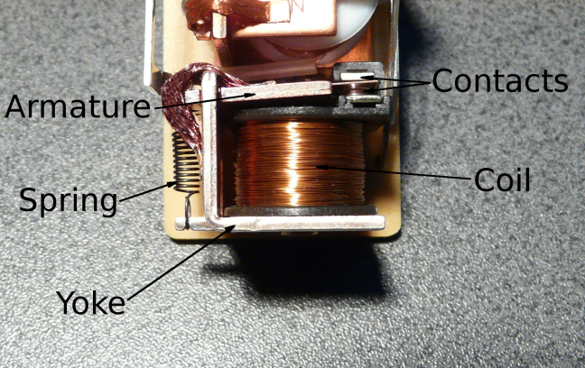
When the coil is energized with direct current, a diode is often placed across the coil to dissipate the energy from the collapsing magnetic field at deactivation, which would otherwise generate a voltage spike dangerous to semiconductor circuit components. Some automotive relays include a diode inside the relay case. Alternatively, a contact protection network consisting of a capacitor and resistor in series (snubber circuit) may absorb the surge. If the coil is designed to be energized with alternating current (AC), a small copper "shading ring" can be crimped to the end of the solenoid, creating a small out-of-phase current which increases the minimum pull on the armature during the AC cycle.

Slide 5
Types of relay
Latching relay
Latching relay with permanent magnet
A latching relay (also called "impulse", "keep", or "stay" relays) maintains either contact position indefinitely without power applied to the coil. The advantage is that one coil consumes power only for an instant while the relay is being switched, and the relay contacts retain this setting across a power outage. A latching relay allows remote control of building lighting without the hum that may be produced from a continuously (AC) energized coil.
In one mechanism, two opposing coils with an over-center spring or permanent magnet hold the contacts in position after the coil is de-energized. A pulse to one coil turns the relay on and a pulse to the opposite coil turns the relay off. This type is widely used where control is from simple switches or single-ended outputs of a control system, and such relays are found in avionics and numerous industrial applications.

Slide 6
Reed relay
Top, middle: reed switches, bottom: reed relay
A reed relay is a reed switch enclosed in a solenoid. The switch has a set of contacts inside an evacuated or inert gas-filled glass tube which protects the contacts against atmospheric corrosion; the contacts are made of magnetic material that makes them move under the influence of the field of the enclosing solenoid or an external magnet.
Reed relays can switch faster than larger relays and require very little power from the control circuit. However, they have relatively low switching current and voltage ratings. Though rare, the reeds can become magnetized over time, which makes them stick 'on' even when no current is present; changing the orientation of the reeds with respect to the solenoid's magnetic field can resolve this problem.
Sealed contacts with mercury-wetted contacts have longer operating lives and less contact chatter than any other kind of relay.

Slide 7
Mercury-wetted relay
A mercury-wetted reed relay that has AC/DC switching specifications of 100 W, 500 V, 2 A maximum
A mercury-wetted reed relay is a form of reed relay in which the contacts are wetted with mercury. Such relays are used to switch low-voltage signals (one volt or less) where the mercury reduces the contact resistance and associated voltage drop, for low-current signals where surface contamination may make for a poor contact, or for high-speed applications where the mercury eliminates contact bounce. Mercury wetted relays are position-sensitive and must be mounted vertically to work properly. Because of the toxicity and expense of liquid mercury, these relays are now rarely used.
Mercury relay
A mercury relay is a relay that uses mercury as the switching element. They are used where contact erosion would be a problem for conventional relay contacts. Owing to environmental considerations about significant amount of mercury used and modern alternatives, they are now comparatively uncommon.

Slide 8
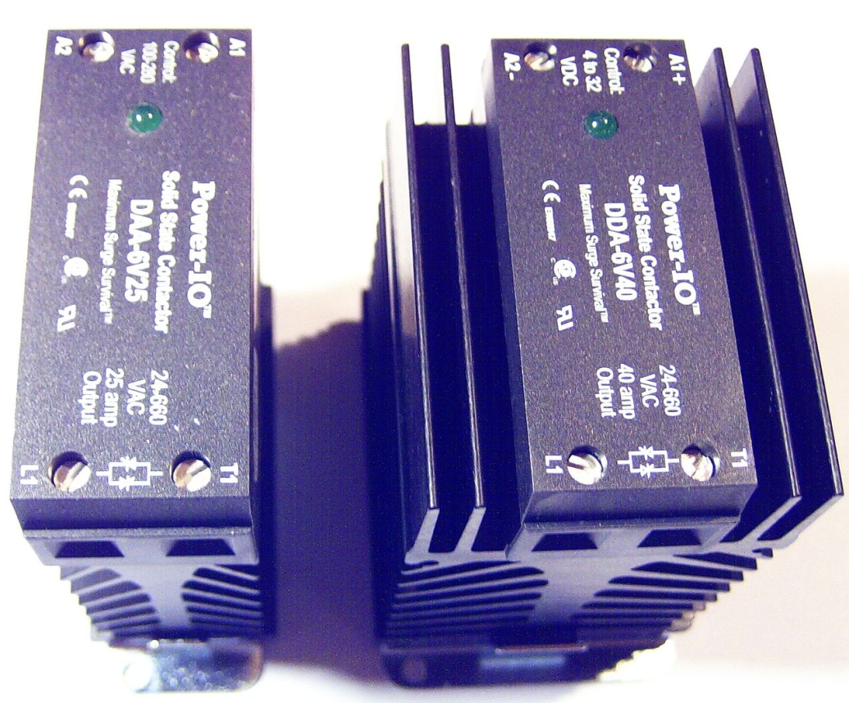
Machine tool relay
Coaxial relay
Contactor
Solid state contactor relay
Solid-state relay
Forced-guided contacts relay
Overload protection relay
Vacuum relays
Buchholz relay
A Buchholz relay is a safety device sensing the accumulation of gas in large oil-filled transformers, which will alarm on slow accumulation of gas or shut down the transformer if gas is produced rapidly in the transformer oil.

Slide 9
Relay testings
Relay performance tests address two questions. Is the relay operating as it was designed? Is the relay being applied properly? Integrity tests are intended to answer the first, and application tests the second. In the past, users have concentrated on integrity tests using relatively simple equipment in the field. Application tests required bulky and expensive equipment which was usually only available in relay manufacturers' plants, or in research laboratories. Historically, field test equipment was only suitable for steady-state tests and limited dynamic state simulations. Manufacturers and users developed comprehensive test plans to ensure the integrity of relays using passive test equipment. Integrity tests were also designed to be performed in the field using simple equipment. With common applications, the manufacturers application tests done during relay development will usually suffice to ensure correct operation under normal circumstances.

Slide 10
Type Tests
Type tests are required to prove that a relay meets the published specification and complies with all relevant standards. Since the principal function of a protection relay is to operate correctly under abnormal power conditions, it is essential that the performance be assessed under such conditions. Comprehensive type tests simulating the operational conditions are therefore conducted at the manufacturer's works during the development and certification of the equipment.
The standards that cover most aspects of relay performance are IEC 60255 and ANSI C37.90. However compliance may also involve consideration of the requirements of IEC 61000, 60068 and 60529, while products intended for use in the EEC also have to comply with the requirements of Directives 89/336/EEC and 73/23/EEC. Since type testing of a digital or numerical relay involves testing of software as well as hardware, the type testing process is very complicated and more involved than a static or electromechanical relay.

Slide 11
Commissioning Tests
These tests are designed to prove that a particular protection scheme has been installed correctly prior to setting to work. All aspects of the scheme are thoroughly checked, from installation of the correct equipment through wiring checks and operation checks of the individual items of equipment, finishing with testing of the complete scheme.
Periodic Maintenance Checks
These are required to identify equipment failures and degradation in service, so that corrective action can be taken. Because a protection scheme only operates under fault conditions, defects may not be revealed for a significant period of time, until a fault occurs. Regular testing assists in detecting faults that would otherwise remain undetected until a fault occurs.
Rating Tests
Rating type tests are conducted to ensure that components are used within their specified ratings and that there are no fire or electric shock hazards under a normal load or fault condition of the power system. This is in addition to checking that the product complies with its technical specification. The following are amongst the rating type tests conducted on protection relays, the specified parameters are normally to IEC 60255-6.

Slide 12
Functional Tests
The functional tests consist of applying the appropriate inputs to the relay under test and measuring the performance to determine if it meets the specification. They are usually carried out under controlled environmental conditions. The testing may be extensive, even where only a simple relay function is being tested., as can be realised by considering the simple overcurrent relay element of Table 21.1.
To determine compliance with the specification, the tests listed in Table 21.2 are required to be carried out. This is a time consuming task, involving many engineers and technicians. Hence it is expensive.
When a modern numerical relay with many functions is considered, each of which has to be type-tested, the functional type-testing involved is a major issue. In the case of a recent relay development project, it was calculated that if one person had to do all the work, it would take 4 years to write the functional type-test specifications, 30 years to perform the tests and several years to write the test reports that result.

Slide 13
D.C Interrupt Test
This is a test to determine the maximum length of time that the relay can withstand an interruption in the auxiliary supply without de-energising, e.g. switching off, and that when this time is exceeded and it does transiently switch off, that no maloperation occurs.
It simulates the effect of a loose fuse in the battery circuit, or a short circuit in the common d.c. supply, interrupted by a fuse. Another source of d.c. interruption is if there is a power system fault and the battery is supplying both the relay and the circuit breaker trip coils. When the battery energises the coils to initiate the circuit breaker trip, the voltage may fall below the required level for operation of the relay and hence a d.c. interrupt occurs. The test is specified in IEC 60255-11 and comprises a interruptions of 2, 5, 10, 20, 50, 100 and 200ms. For interruptions lasting up to and including 20ms, the relay must not de-energise of maloperate, while for longer interruptions it must not maloperate.

Slide 14
Dynamic Relay Testing
Dynamic relay testing means testing under true simulated power system conditions. Depending on the level of testing reąuired, test values can be easily calculated with PC-based short circuit or EMTP programs. For dynamic-state testing, a short circuit program would be used to calculate the fundamentai component of voltage and current values for pre-fault and fault conditions. For transient simulations, an EMTP program would be used to create waveforms that represent the fault condition. Dynamic-state testing and transient simulations provide a faster and more meaningful way to test relays and relay systems. These techniąues provide the user with a far better understanding of how the relay system performs and can aid both relay application and test engineers in evaluating relay operations.
Dynamic-state testing is based on a power system model that is used to simulate different events selected according to the application. Events are played back through power system simulators that also monitor scheme performance. Each event is modeled to simulate conditions for the tested relay circuit but only for the time period needed to test.

Slide 15
QUESTIONS ?

Slide 16

THANK YOU FOR YOUR ATTENTION!

