Slide 1
Protection Relay Modeling for Transient Stability Simulation
10/26/2016
CJ Jing, David Franklin, Kevin Moran

Slide 2
Background
In May of 2012, the Federal Energy Regulatory Commission (FERC) and North American Electric Reliability Corporation (NERC) issued a joint report on the September 8, 2011 Southwest Blackout Event. It recommended that entities throughout WECC identify and plan for external contingencies that could impact their systems and internal contingencies that could impact their neighbors’ systems, and expand entities’ external visibility in their models through, for example, more complete data sharing.
One of the reasons for cascading outage is that the complicated interaction of relays may inadvertently trigger the cascading outage. Manually simulating contingencies with a simple relay modeling cannot identify these kind of problems due to inadequate modeling of relays.

Slide 3
Background – cont’d
The current methodology in the contingency list development involves creating actions which are believed to represent the automatic actions of the relays. With the current methodology, assumptions are made on the timing of the relay action.
Implementing relay models will improve both the accuracy of actions and timing in the contingencies. A switching definition will no longer need to specify when to clear the fault. Rather, the contingency list will only require the application of the fault. Also, the assumptions in the contingency list made on the timing of the actions will no longer be needed.
With automatically comprehensive relay modeling, we will be in a better position to understand how all relays work together following the contingencies. With the automatic simulation of full relay modeling, some issues may be discovered that haven’t been previously observed before.

Slide 4
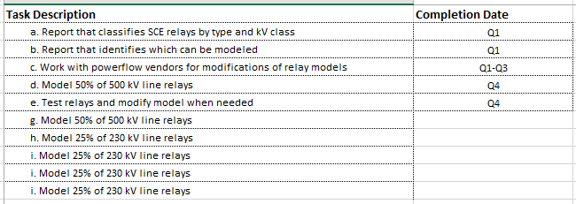
Overall Goals – Model Relays for All 230 kV and above Lines

Slide 5
Relay Types to be Modeled
Differential relay
Distance relay
Load encroachment definition for WECC Distance and Overcurrent relay
Zone definition for WECC Distance relay
Blinder definition for WECC Distance relay
DIRECLEN (Directional Element for the Overcurrent relay)

Slide 6
Work Estimate
With approximately 30 variables for each relay, the grand total number of variables is 29,280, which needs to be mapped, entered, and checked.
 | Number of Lines | Minimum Number of Relays on Each Side of Each Type | Total Number of Relays
500 kV Lines | 34 | 3 | 204
230 kV Lines | 193 | 2 | 772

Slide 7
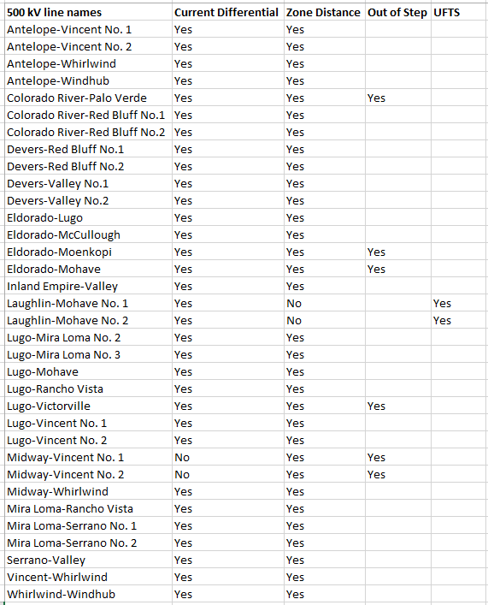
Relay Types to be Modeled for 500 KV Lines

Slide 8
PROTECTION ENGINEERING RELAY SETTINGS
Relay Type: D60
34 pages
Big data
Need some calculations
Also equivalent
Very time consuming

Slide 9
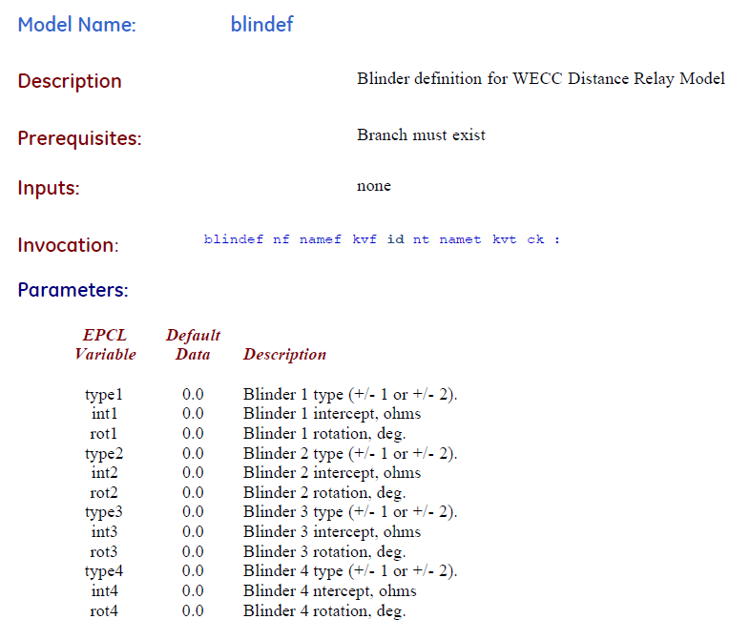
Sample Data Format - 1

Slide 10
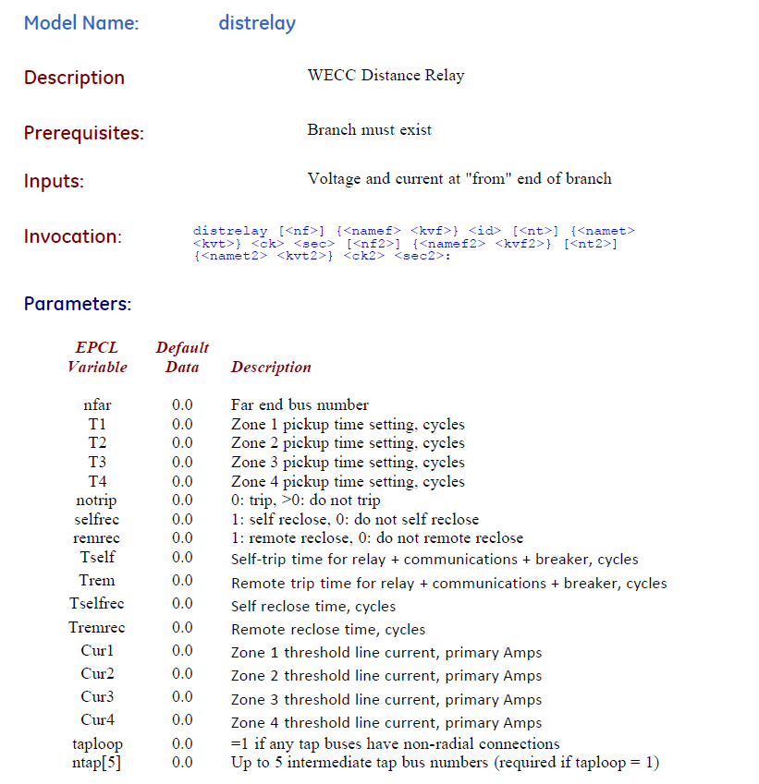
Sample Data Format - 2

Slide 11
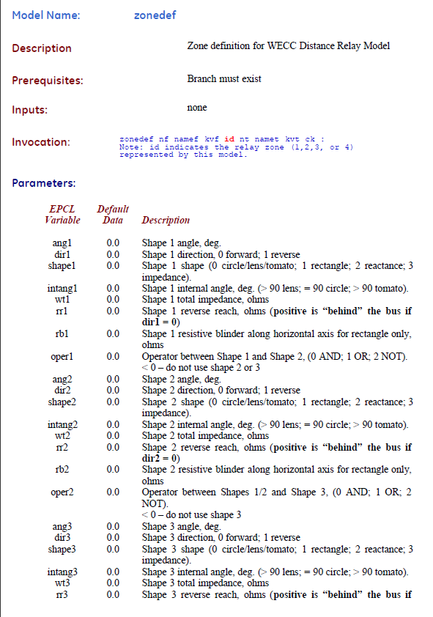
Sample Data Format - 3

Slide 12
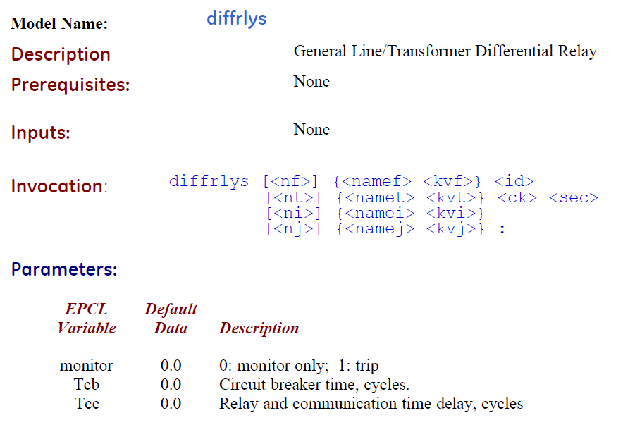
Sample Data Format - 4

Slide 13
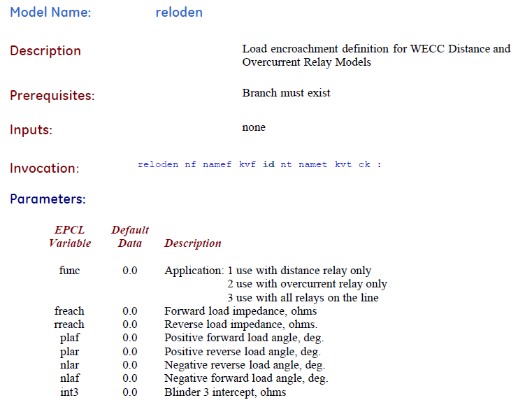
Sample Data Format - 5

Slide 14
Relay Modeling Process

Slide 15
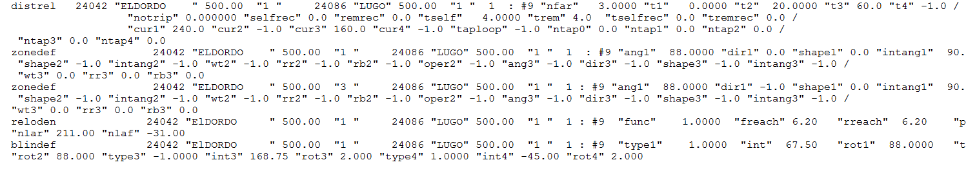
Sample Data File
In dyd file

Slide 16
Protection Relay Simulation Results

Slide 17
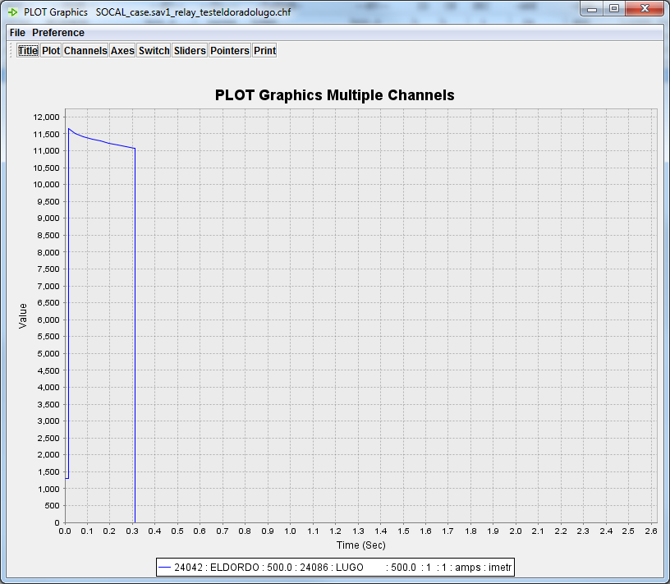
Protection Relay Simulation Results
Run simulation with the following fault. line "ELDORDO" 500.0 "LUGO" 500.0 "1 " is modeled with zonedef and distrelay.
At 1 cycle, apply a 3 phase fault at line "ELDORDO" 500.0 "LUGO" 500.0 "1 ", 85% from the from bus with fault r = 0.01, x = 0.001
Line current "ELDORDO" 500.0 "LUGO" 500.0 "1 "

Slide 18
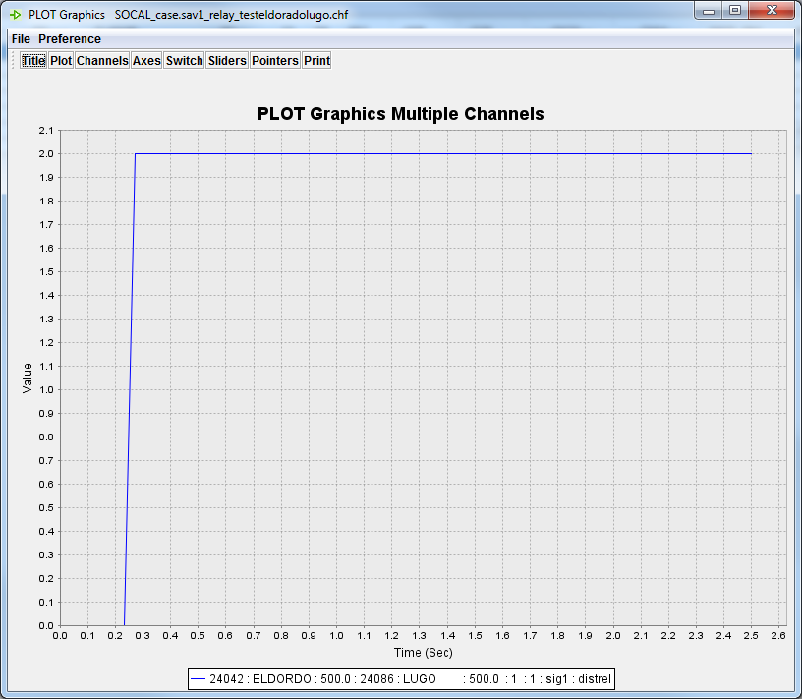
Protection Relay Simulation Results
Zone 1 signal, Timed out, trip initiated

Slide 19
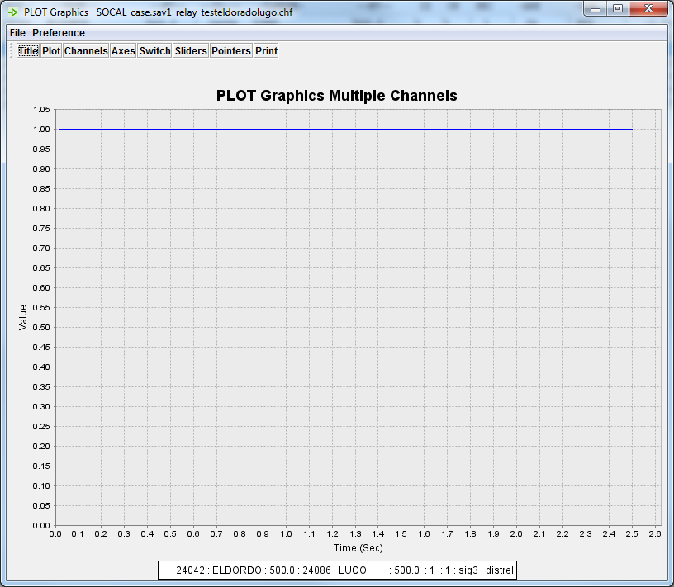
Protection Relay Simulation Results
Zone 3 signal (picked up (in zone) and timing, trip not initiated

Slide 20
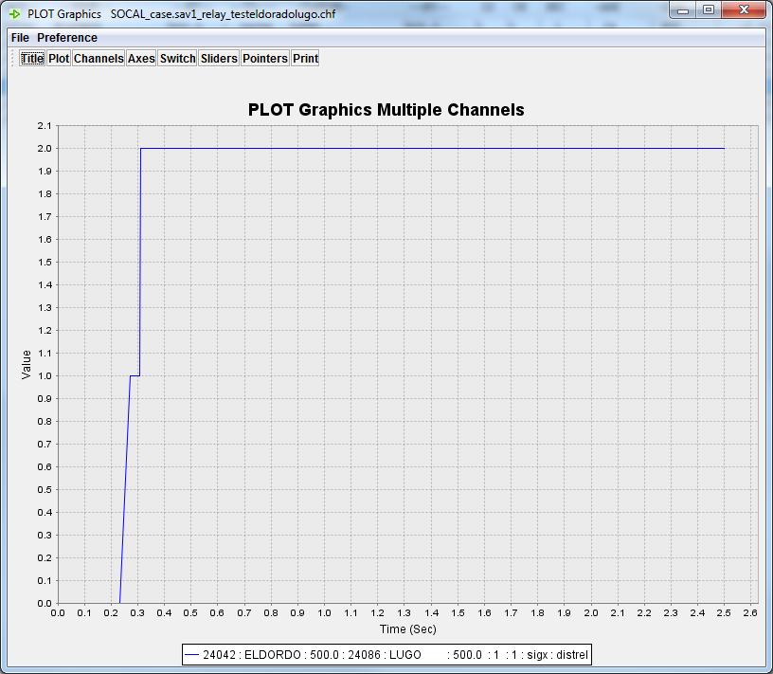
Protection Relay Simulation Results
Circuit breaker timer signal; signal = 1 trip initiated, cb timer running
signal = 2 circuit breaker tripped

Slide 21
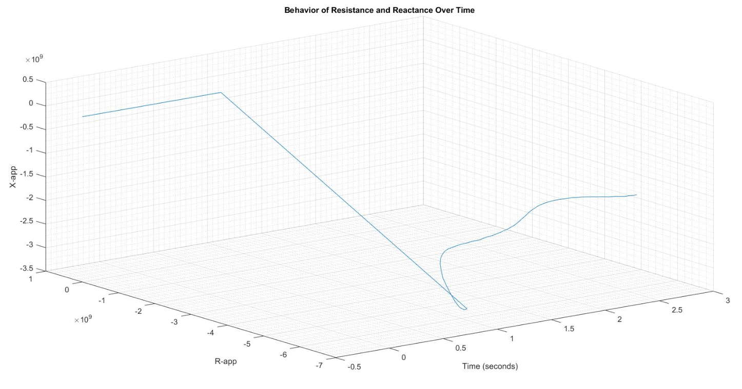
Protection Relay Simulation Results

Slide 22
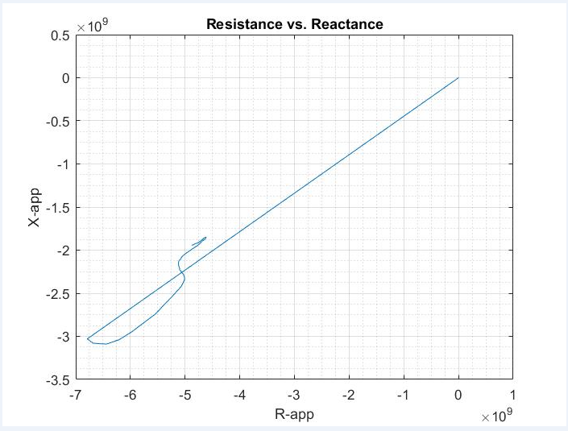
Protection Relay Simulation Results

Slide 23
Conclusions
With full relay modeling in the simulation, we may reveal some inadvertent conflict interactions of relay settings.
Study cascading outage in the transient simulation.
Improve the power grid reliability and prevent cascading outage and black out more effectively.

