Slide 1
Enzyme Kinetics
C483 Spring 2013

Slide 2
Questions
1. Enzymes that join two substrates and require energy of a nucleoside triphosphate (such as ATP) to do so are called
A) isomerases.
B) lyases.
C) ligases.
D) hydrolases.
E) Both c and d.
2. Which is an appropriate experiment to analyze an enzyme-catalyzed reaction?
A) Substrate concentration is constant and the initial rate is measured at
different concentrations of enzyme.
B) Enzyme concentration is constant and the initial rate is measured at
different substrate concentrations.
C) Substrate concentration is constant and the half-maximal rate is measured
at different concentrations of enzyme.
D) Enzyme concentration is constant and the half-maximal rate is measured at
different substrate concentrations.

Slide 3
3. When varying the substrate concentration at a fixed concentration of enzyme it is observed that at low concentrations of substrate the reaction is ________, while at high concentrations of substrate the reaction is ________.
A) maximal; initial
B) initial; maximal
C) second order; first order
D) first order; second order
E) first order; zero order
4. What is the shape of a typical plot of initial rate vs. substrate concentration for an enzyme catalyzed reaction that follows Michaelis-Menton kinetics?
A) Sigmoidal.
B) Parabolic.
C) Sinusoidal.
D) Bell curve.
E) Hyperbolic.
5. The time that is required for an enzyme to convert one substrate molecule into one product molecule is
A) Km.
B) kcat.
C) 1/Km.
D) 1/kcat.

Slide 4
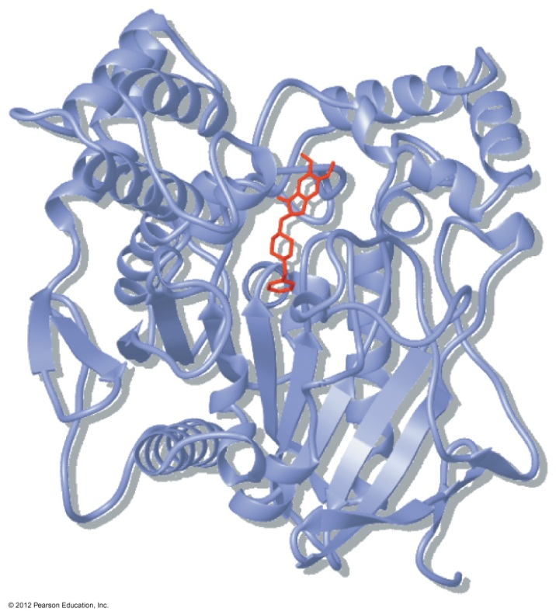
Enzymes
Biocatalyst—active site
Proteins
Substrate
Reaction specificity
Stereospecificity
Coupled reactions
Regulation

Slide 5
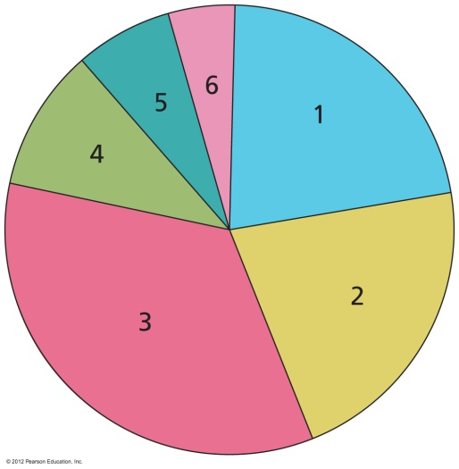
Enzyme Classes
Oxidoreductase
Transferase

Slide 6
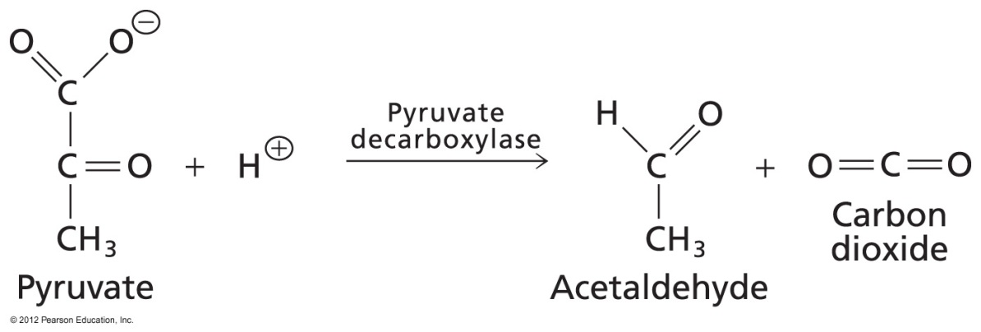
Enzyme Classes
Hydrolase
Lyase

Slide 7
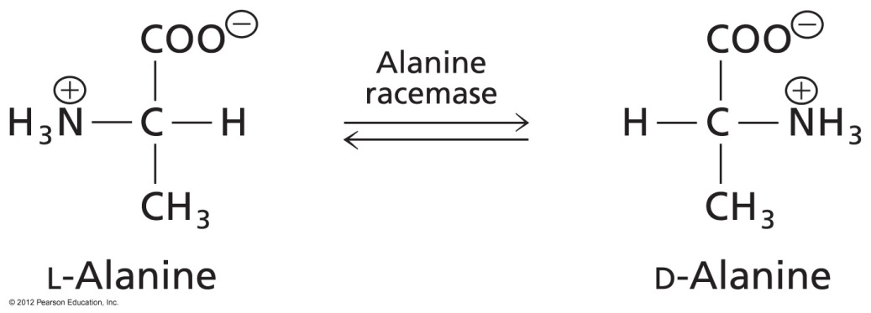
Enzyme Classes
5. Isomerase
6. Ligase

Slide 8
Enzyme Kinetics
How fast an enzyme catalyzed reaction goes
Why study enzyme kinetics?
Helps us understand mechanism of enzyme (how it works)
Investigation of mutations in metabolic pathways
Understanding of regulation of biochemical reactions (up or down regulation of catalyst)

Slide 9
Simple Mechanisms
Chemical mechanism
Enzyme Catalyzed
How do we measure kinetics experimentally?

Slide 10
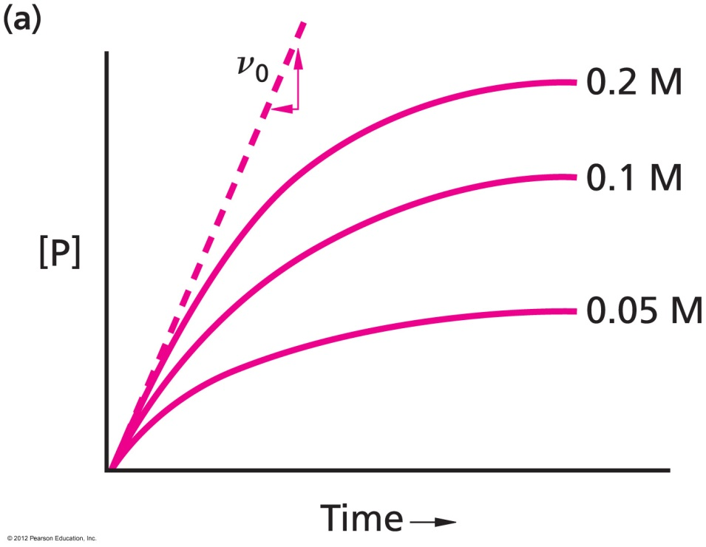
Chemical Kinetics
Rate: measure product formed per second
Rate slows as reactant disappears
Measure initial rate
Do a second experiment with more starting material, and the initial rate is faster

Slide 11
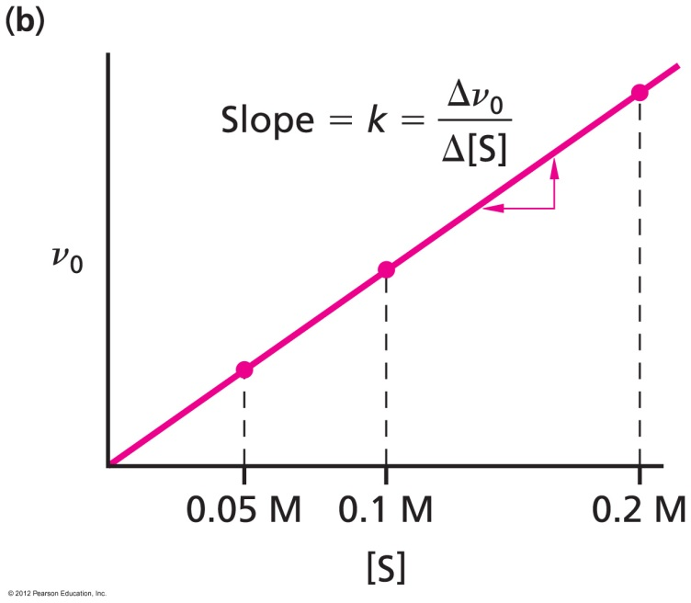
Chemical Kinetics
Secondary plot: change in rate as a function of how much substrate you started with
Linear plot—does that make sense?

Slide 12
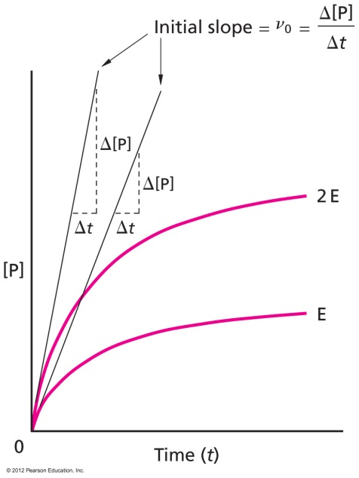
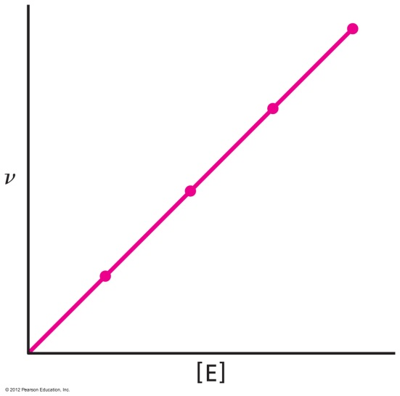
Enzyme Kinetics
Complicated—two components, treated separately
First, how does [enzyme] affect rate (given large [S]?

Slide 13
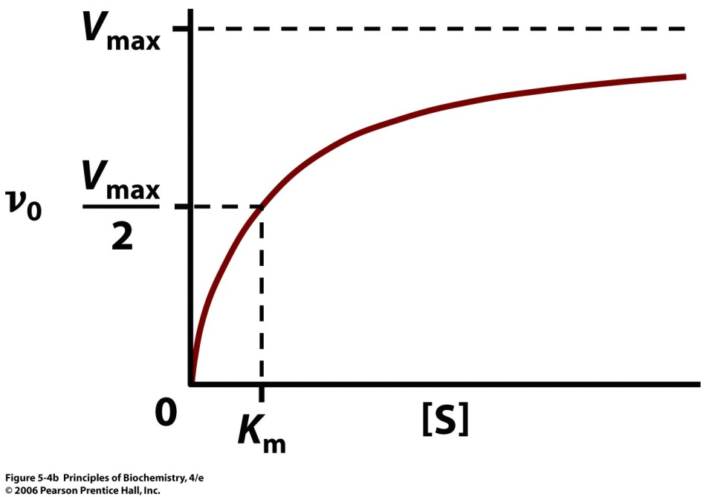
Enzyme Kinetics
Next, keep the [E] constant and low, and test how changing the [S] affects initial rates
Michaelis-Menton Treatment
[Product]
Time

Slide 14
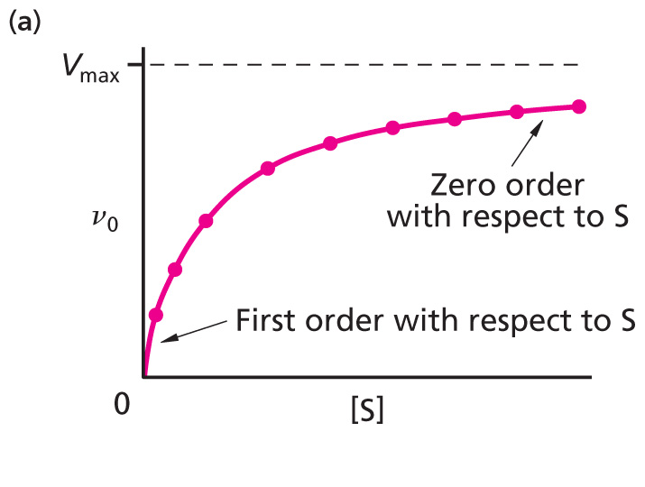
Interpretation of Shape
Low [S]
Rate very dependent on [S]
Binding is rate limiting
High [S]
Rate independent
Saturation of E
Chemistry is rate limiting

Slide 15
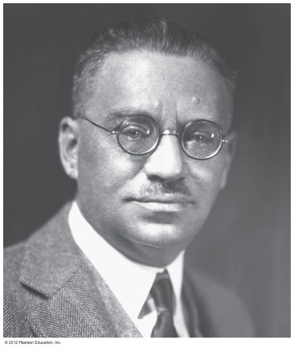
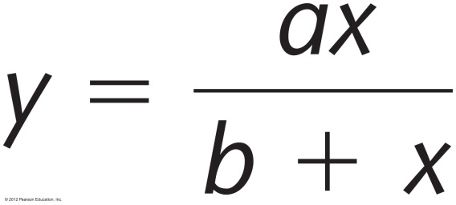
Michaelis-Menton Kinetics
Rectangular hyperbola
Parameters
V_{max} [S]
v_{o} = -------------
K_{m} + [S]

Slide 16
Kinetic Parameters
What are V_{max} and K_{m}?
Can derive the M-M equation under a set of assumptions, using the steady state approximation (section 5.3a)
We don’t need to do that, though, to understand what these parameters tell us about the enzyme’s efficiency and specificity.

Slide 17
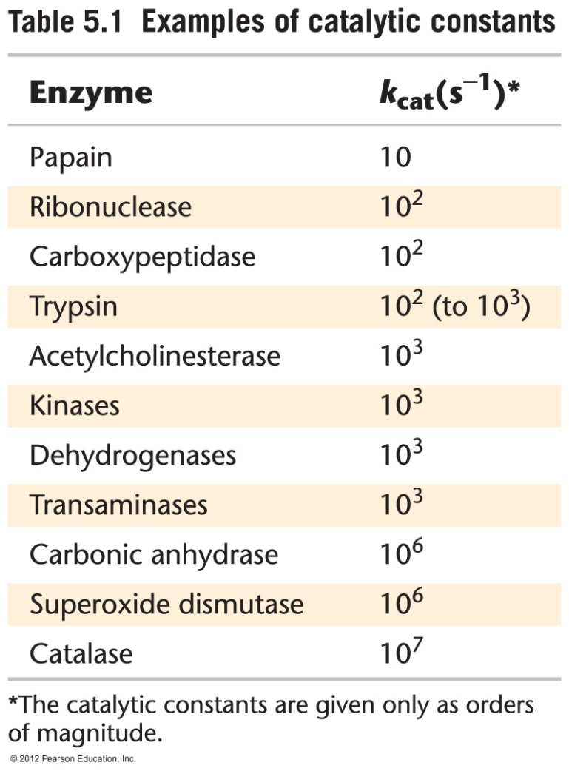
Maximum Velocity and Catalytic Constant
What two things contribute to the maximum velocity limit?
Amount of enzmye
Chemical ability of enzyme (catalytic constant)
V_{max} = [E] k_{cat}
Only k_{cat} tells us about the enzyme
Maximum # of substrate molecules per active site per second
Turnover number

Slide 18
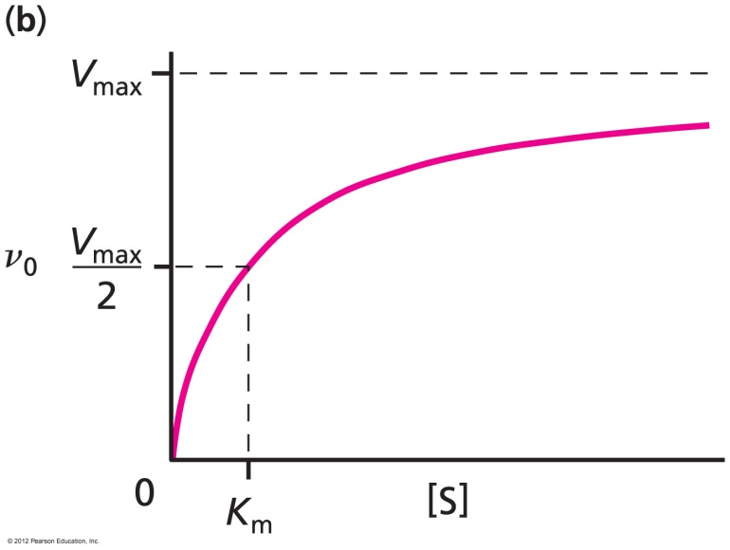
Michaelis Constant
K_{m} is the [S] at which the reaction reaches half its maximum velocity
Physical meaning (assuming equilibrium binding): K_{m} is the dissociation constant for ES
K_{m} is [S] at which enzyme is half-bound
K_{m} is measure of affinity of enzyme for S
Low K_{m} is tight binding

Slide 19
Questions
How would kinetics of enzyme change if a mutant were made with
Tighter binding but same catalytic rate?
Same binding, but slower catalysis?

Slide 20
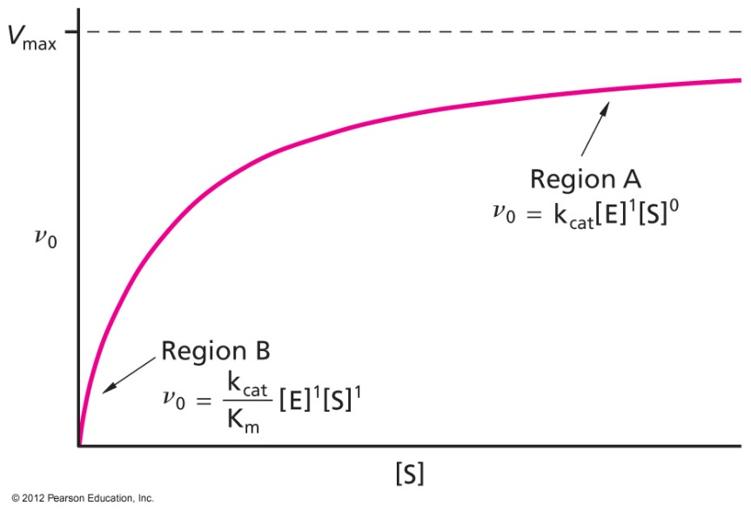
Enzyme Efficiency
At low [S], the second order rate constant is k_{cat}/K_{m}
Efficient enzymes have large k_{cat}/K_{m}
Large k_{cat} and/or
Small K_{m}
Catalytic perfection at 10⁸ or 10⁹ M⁻¹ S⁻¹
Diffusion control
$$v= \frac{k_{cat}\left[E\right][S]}{K_{m}+[S]}$$
Assume large [S] and small [S]

Slide 21
Catalytic Proficiency

Slide 22
Answers
C
B
E
E
D

