Slide 1
Enzyme Mechanisms
C483 Spring 2013

Slide 2
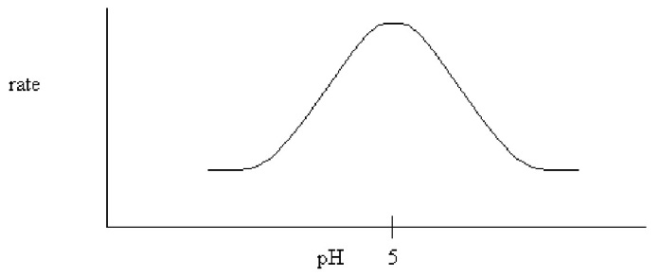
Questions
1. Replacement of the amino acid ________ at or near an active site of an enzyme is more likely to change enzyme activity than the replacement of ________ at or near the active site.
A) histidine; leucine
B) leucine; histidine
C) leucine; isoleucine
D) histidine; aspartate
2. The following pH dependence was found for the activity of a certain enzyme-catalyzed reaction. If it is known that the only two ionizable residues in the active site are both glutamates, which conclusion can be drawn?
A) The glutamates have different microenvironments which cause their pKa's to differ.
B) One of the glutamates must be amidated.
C) Both glutamates have a pKa equal to 5.0.
D) Both glutamates are deprotonated during the reaction.

Slide 3
3. An update of Fischer's lock-and-key theory of enzyme specificity views the ________ as the lock and ________ as the key.
A) enzyme; substrate
B) substrate; enzyme
C) enzyme; transition state
D) transition state; enzyme
E) substrate; transition state
4. One reason the proximity effect enhances catalysis is because
A) the effective molarity of reactive substrate groups increases.
B) the enzyme changes conformation to more readily accept the substrate as it approaches the active site.
C) the active site becomes smaller.
D) the catalytic triad in the active site becomes more flexible.

Slide 4
Mechanisms
Four major mechanisms—any or all may be used in a given enzyme
Binding Mechanisms
Proximity effect
Transition State Stabilization
Chemical Mechanisms
Acid-base catalysis
Covalent Catalysis

Slide 5
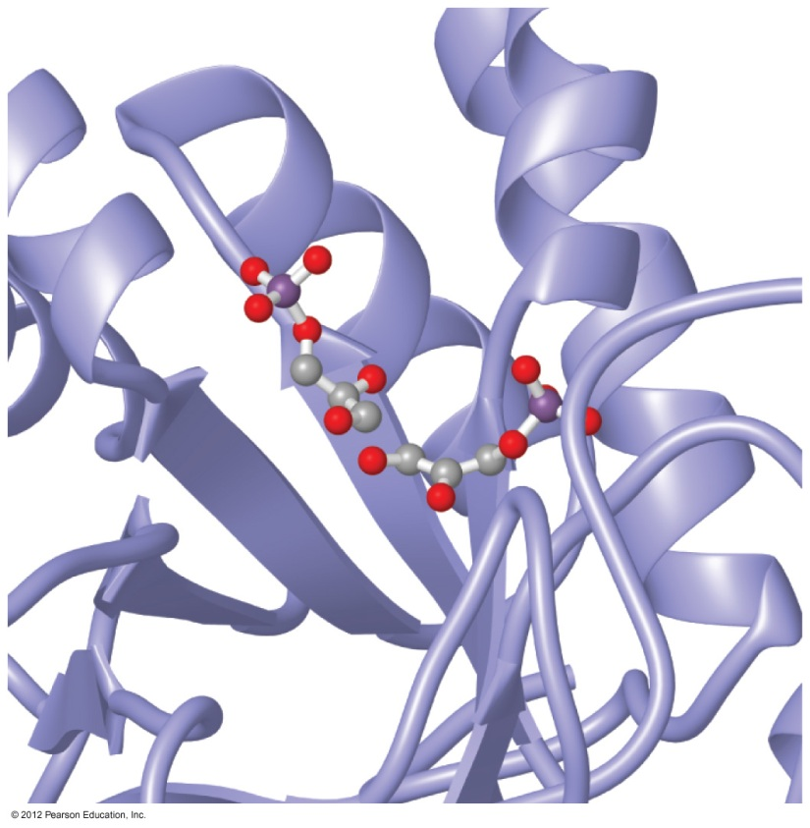
Binding Energy
Binding based on intermolecular forces
“Lock and Key”
Selectivity
Rate Enhancement
Effective concentration
Entropy trap
Productive orientation of two molecules
in the active site

Slide 6
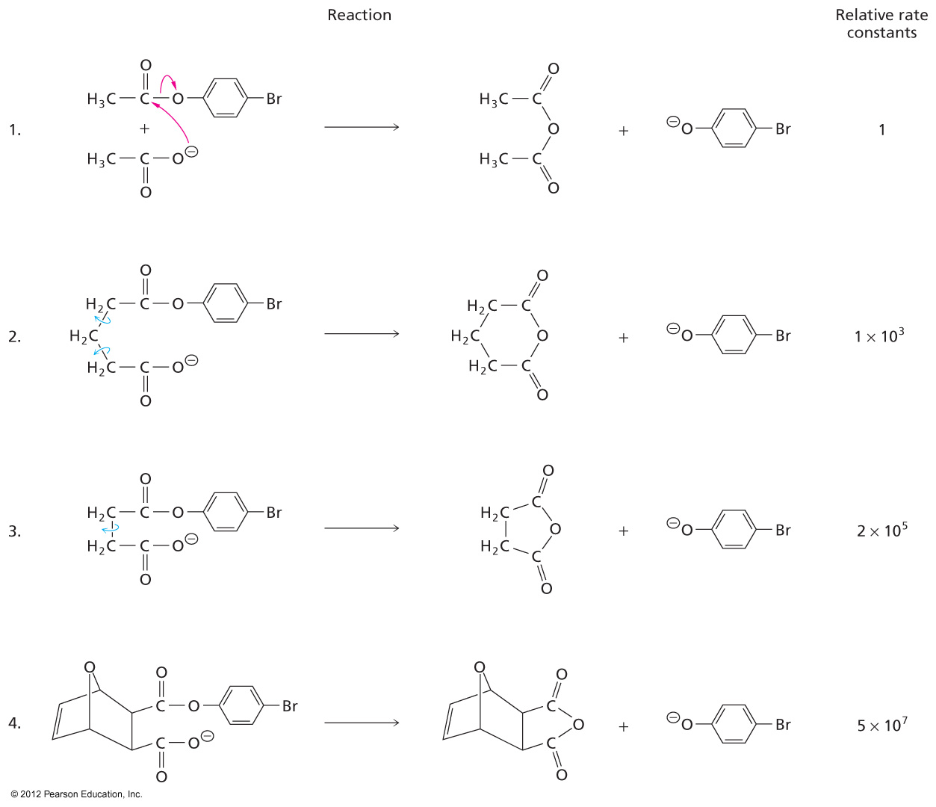
Effective Molarity
May be higher than actual molarity possibility
Entropic help

Slide 7
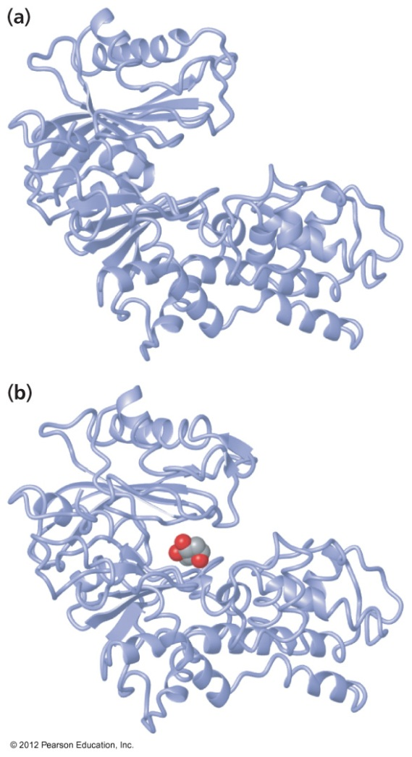
Induced Fit
“Lock and Key” too simplistic
Enzymes are actually somewhat flexible
Substrate specificity comes at catalytic price
k_{cat} = 10³ per second, but worth cost

Slide 8
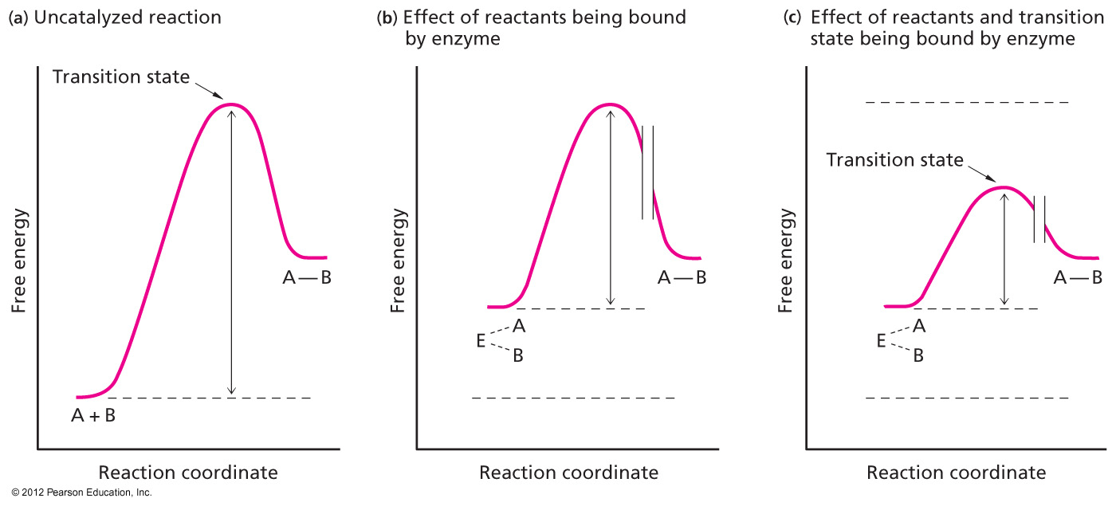
Lowering Activation Energy
Transition state stabilization is half the story

Slide 9
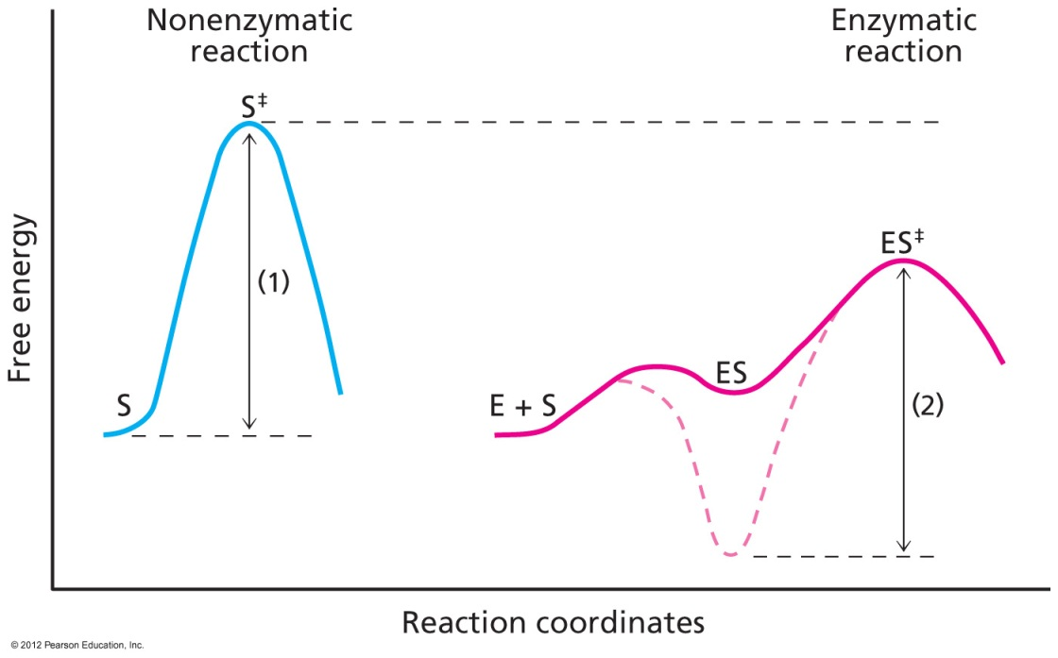
Weak Binding of Substrate
Substrate binding: too much of a good thing
Thermodynamic pit
K_{M} ~ 10⁻⁴ M
Can be 10⁻⁶ M for cofactors

Slide 10
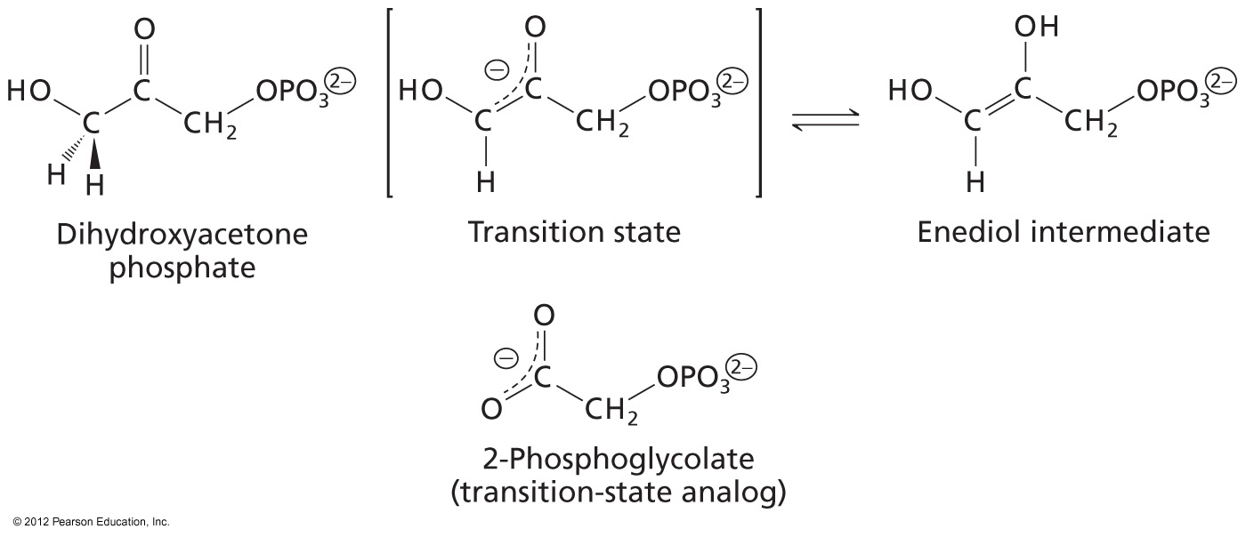
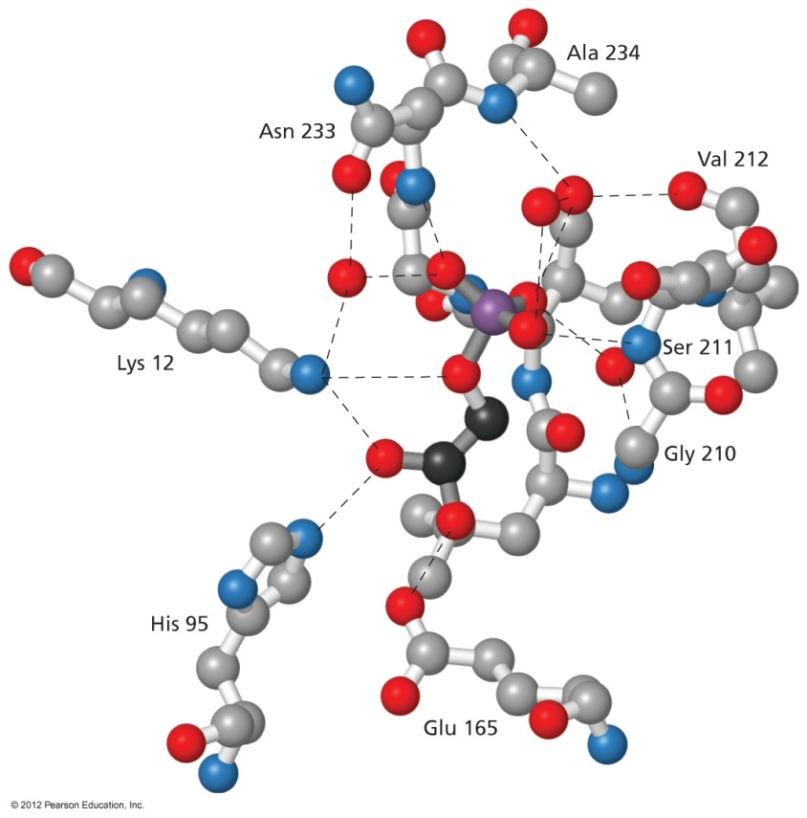
Transition State Binding
Transition State Analogs
Actually, high energy intermediate analog

Slide 11
Designing a Transition State Analog

Slide 12
Binding of Transition State Analog

Slide 13
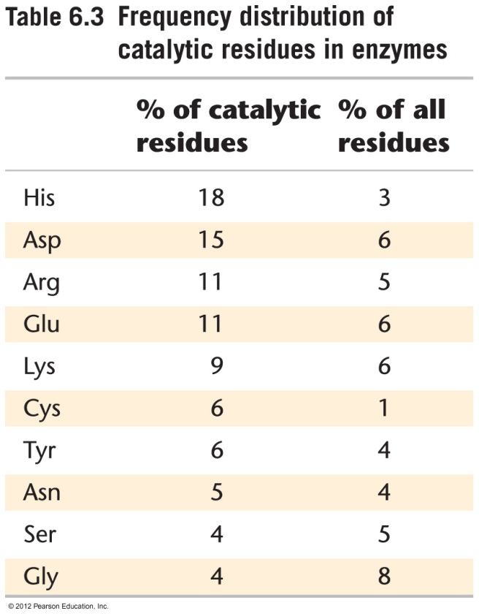
Binding Catalysis and …
Some sidechains occur often in active site
From previous slide, polar and charged amino acids make specific contacts
Charge/charge, H-bond, etc

Slide 14
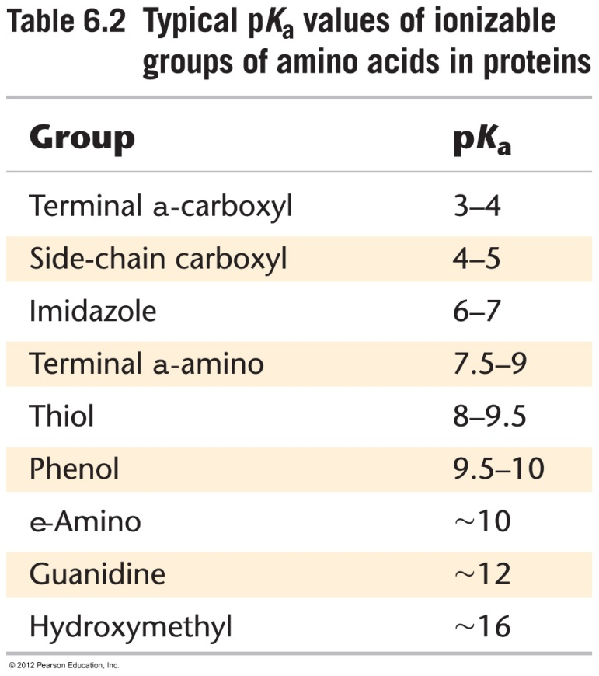
…Chemical Catalysis
The same sidechains that bind can ofter conduct proton transfers
Acid-Base Catalysis

Slide 15
General Acid-Base Catalysis
H⁺ and HO⁻ are “specific acid/base” and depend on pH
Amino acid sidechains are general acid-base, and can conduct reactions inside active site pocket that aren‘t possible in solution

Slide 16
Covalent Catalysis
Active site nucleophile
Group transfer reaction

Slide 17
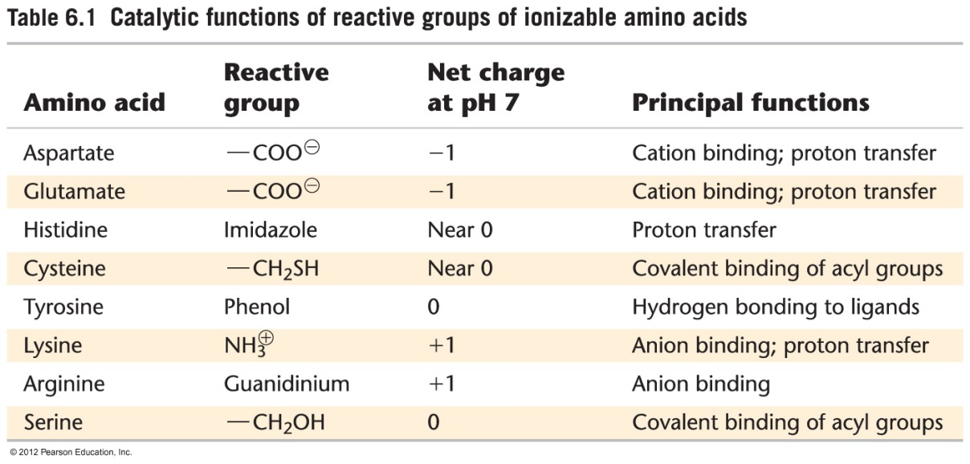
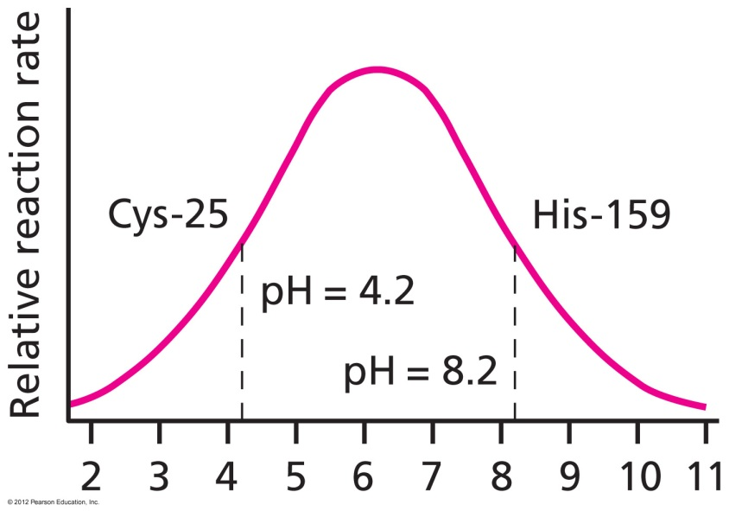
pH affects Enzyme Catalysis
Propose possible explanations of pH profile

Slide 18
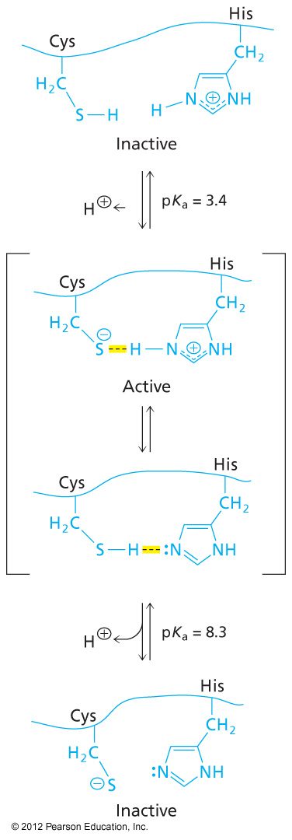

Slide 19
Case Study: Diffusion Controlled Enzymes

Slide 20
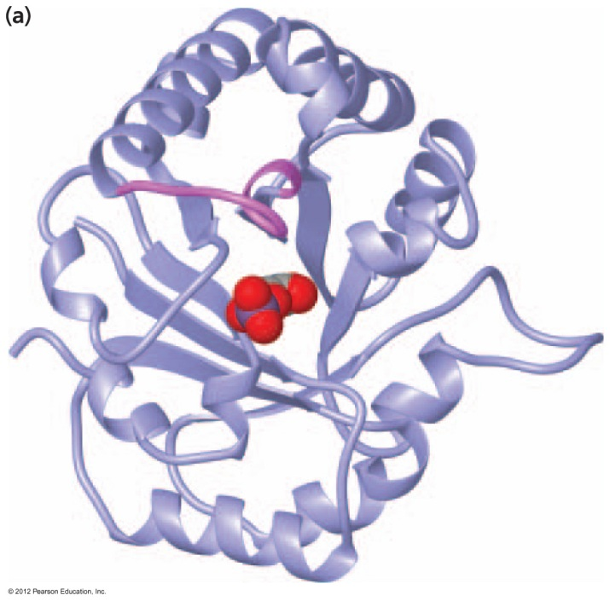
Triose Phosphate Isomerase

Slide 21
Mechanism
Be able to explain catalytic function of AA in each step of a mechanism

Slide 22
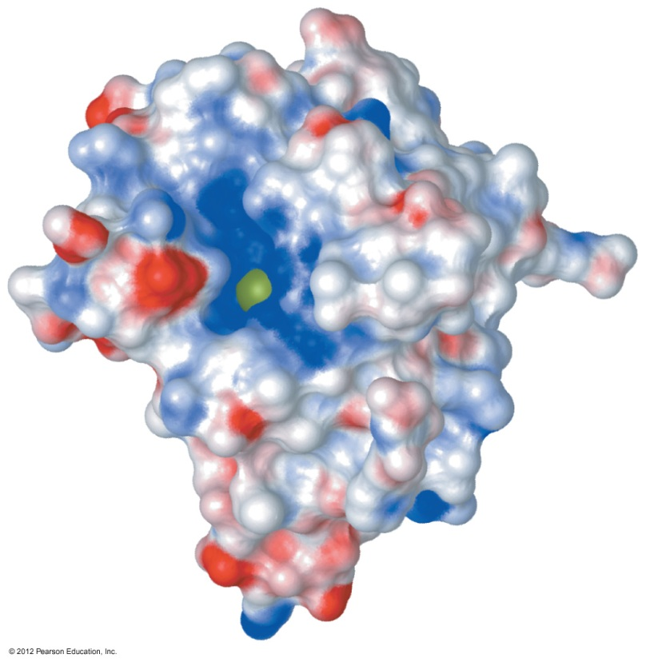
Superoxide Dismutase: Better than Diffusion!

Slide 23
Answers
A
A
C
A

